Slide 1
AVNRT project: recap of results
January 2025
Andrea Corrado

Slide 2
Outline
Problem statement: recap
Feature extraction
Envelope features
Template matching features
Short time Fourier transformation features
Classification
Feature correlation analysis
Knowledge based approach
Machine learning approach: tree - MLR - SVM
Best model evaluation
Conclusions

Slide 3
Outline
Problem statement: recap
Feature extraction
Envelope features
Template matching features
Short time Fourier transformation features
Classification
Feature correlation analysis
Knowledge based approach
Machine learning approach: tree - MLR - SVM
Best model evaluation
Conclusions

Slide 4
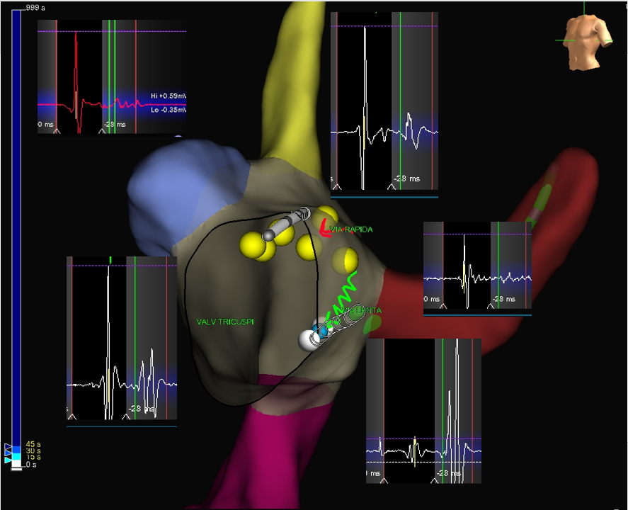
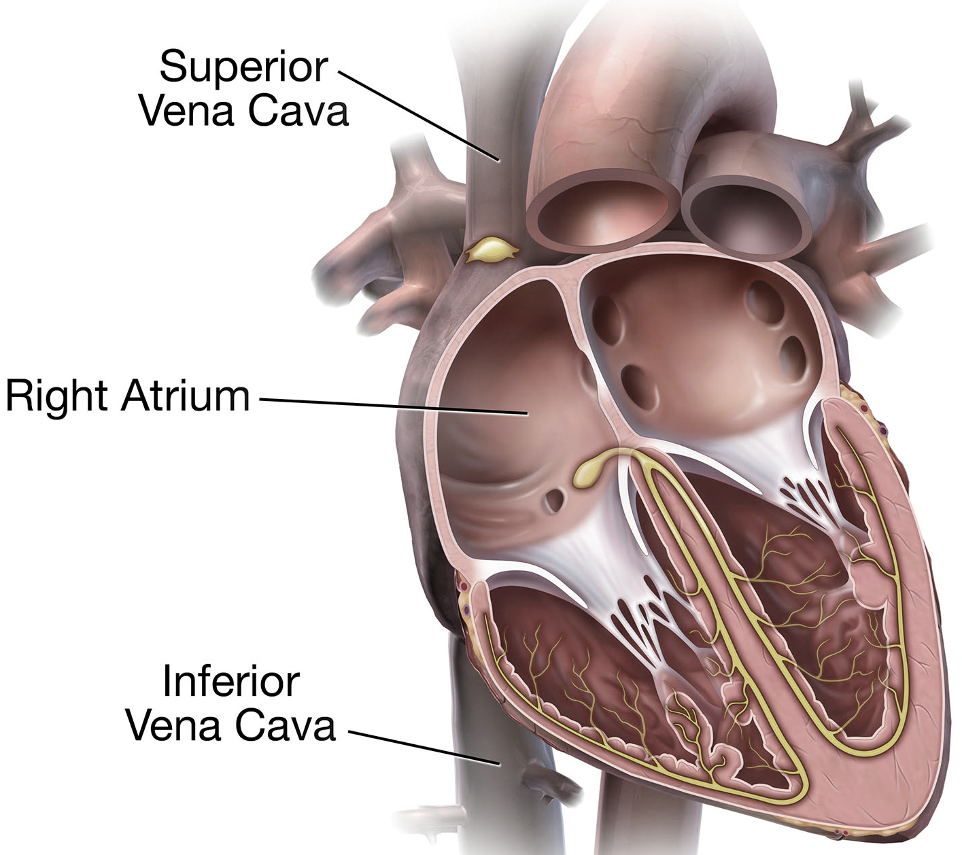

Problem statement: recap
Indifferent
663 examples
Dangerous
PREDICTION
90 examples
DATA PREPROCESSING
Cleaning from unclear traces
Doubled subject (subject 5) and signals removal
Traces alignment
Effective
94 examples

Slide 5
Outline
Problem statement: recap
Feature extraction
Envelope features
Template matching features
Short time Fourier transformation features
Classification
Feature correlation analysis
Knowledge based approach
Machine learning approach: tree - MLR - SVM
Best model evaluation
Conclusions

Slide 6
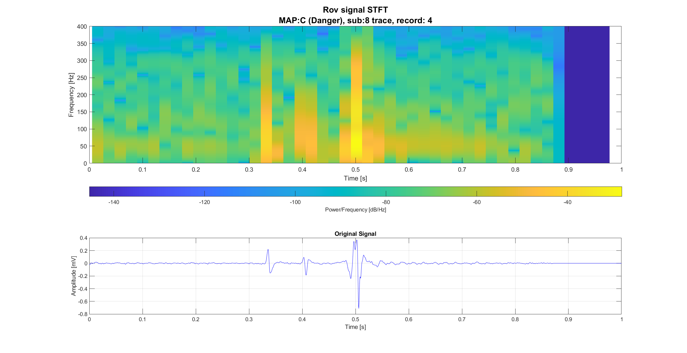
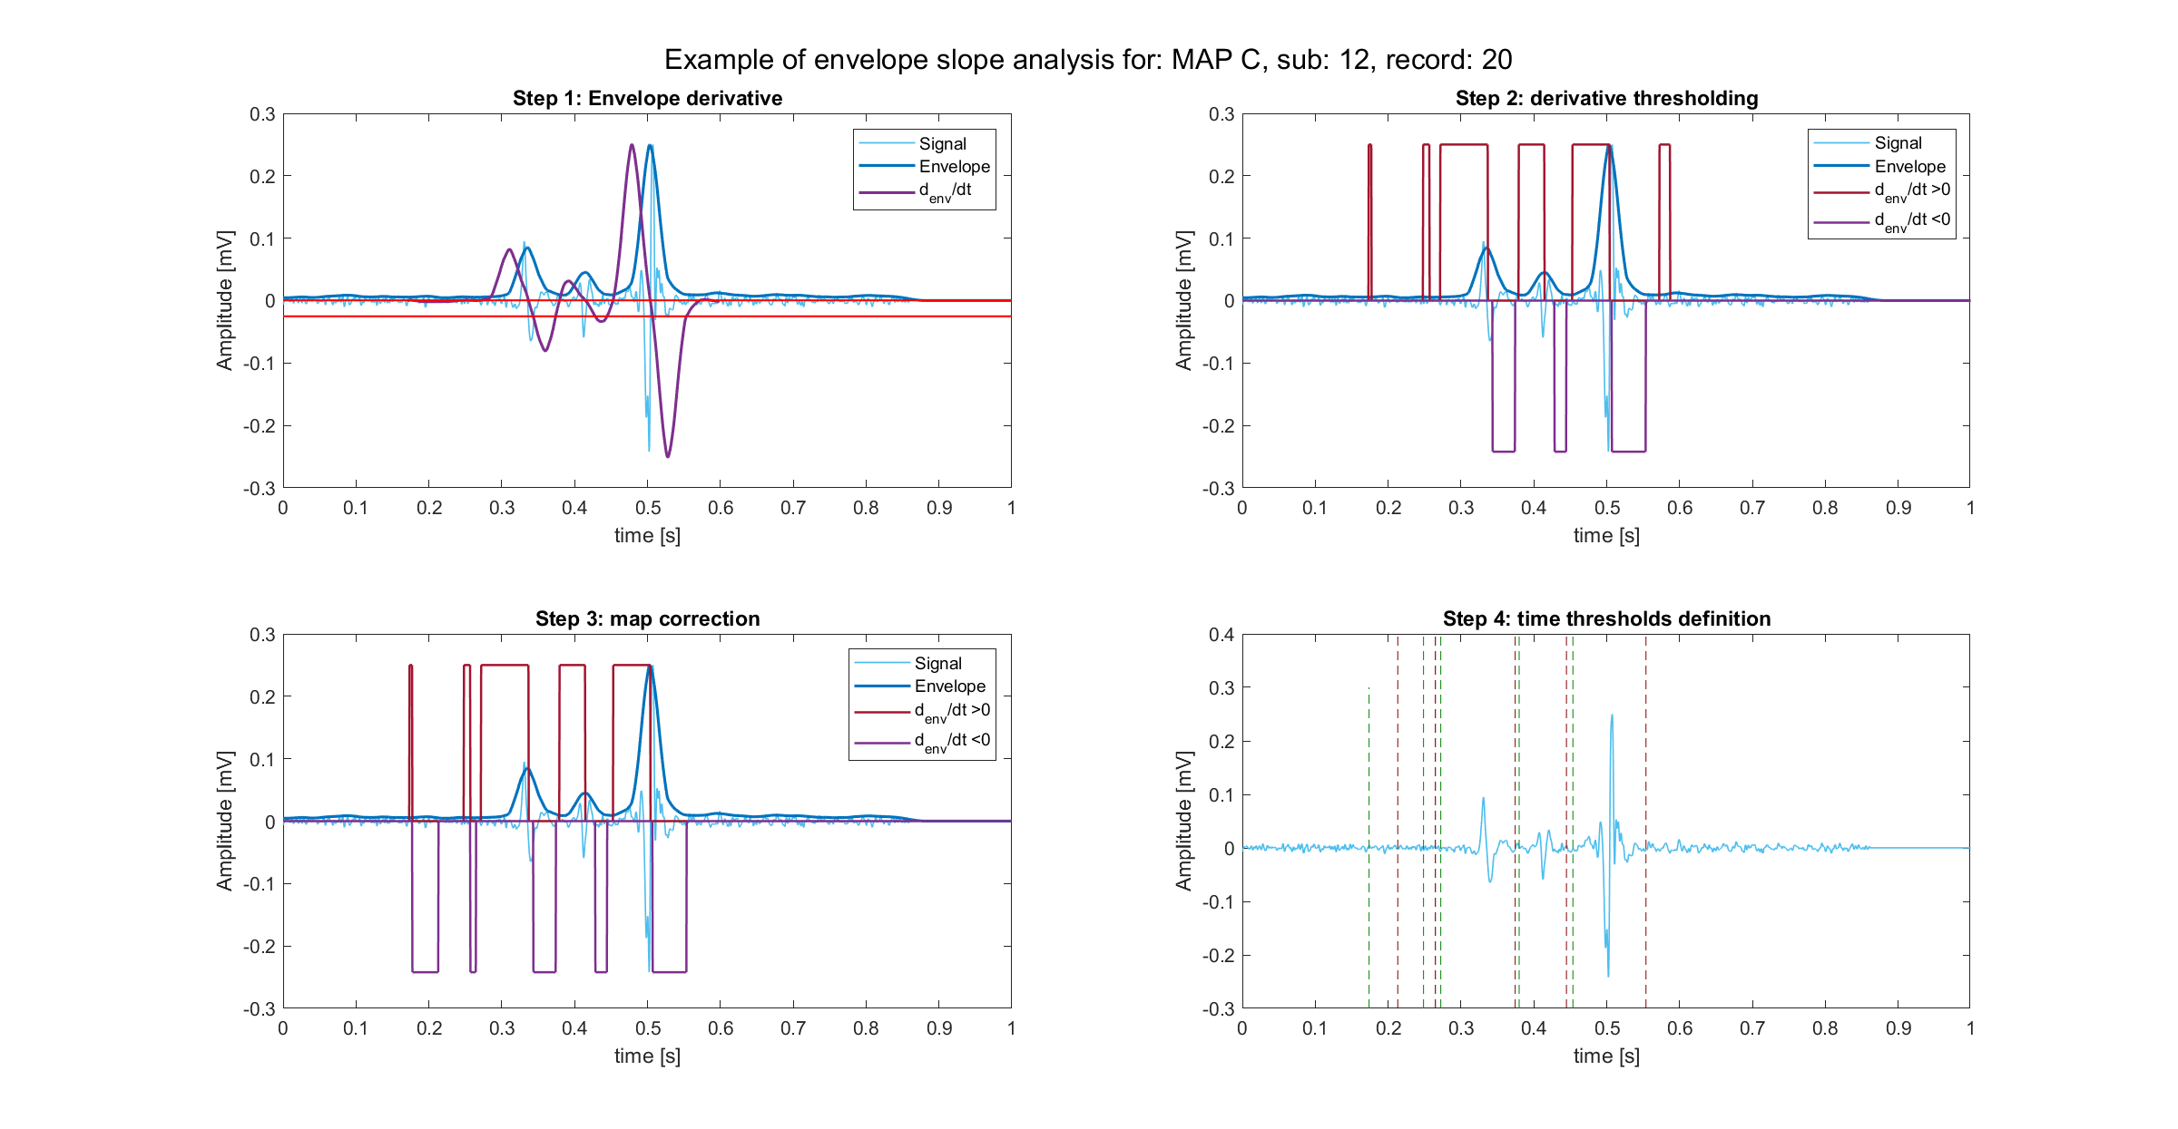
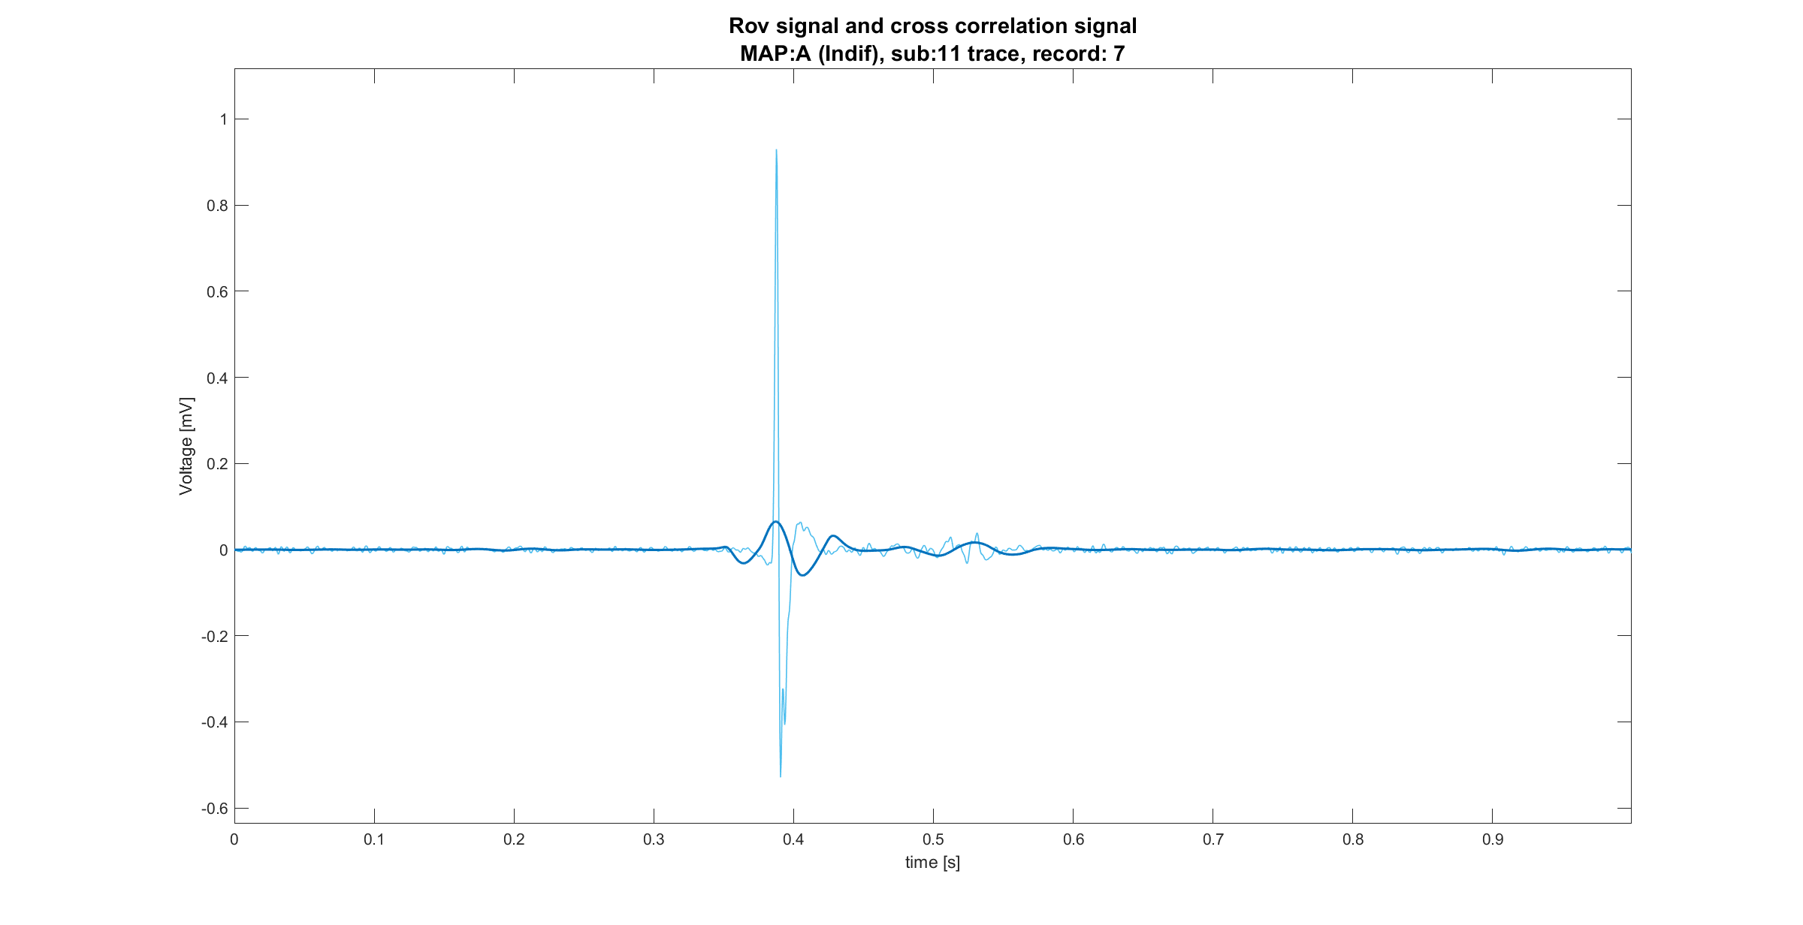
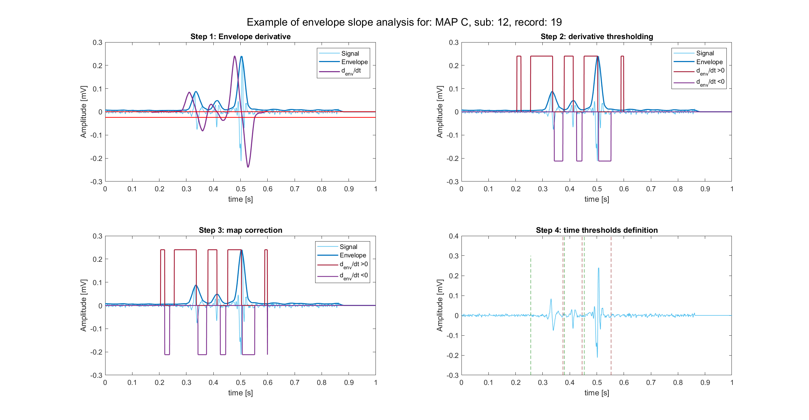
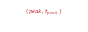
Feature extraction pipeline overview
Metti literature based features tra morphological e envelope. Puoi anche togliere le immagini
Feature extraction
Envelope based
Template matching
STFT based
Signal active areas
Morphological information
Time-frequency information
$$(peak,t_{peak})$$

Slide 7
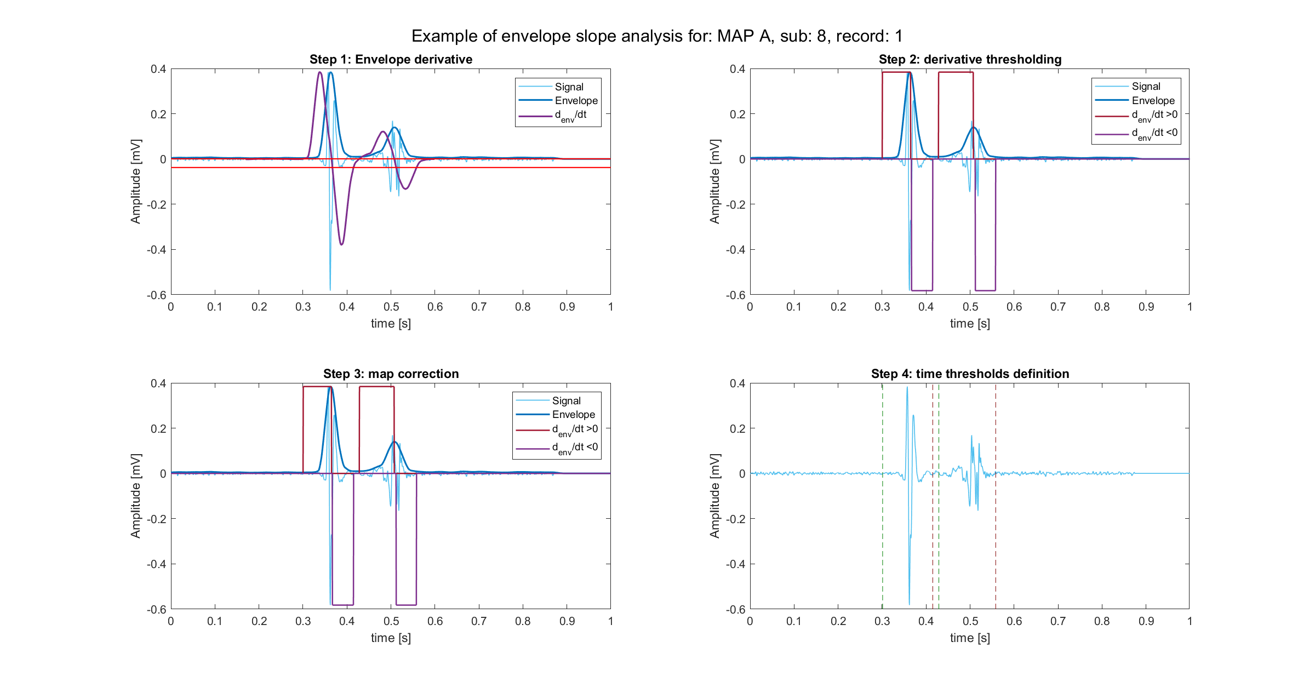
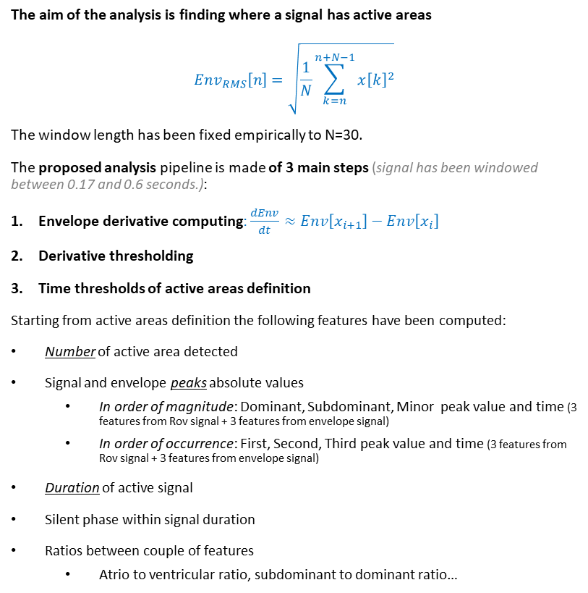
Envelope features definition
The aim of the analysis is finding where a signal has active areas
$$Env_{RMS}\left[n\right]=\sqrt{\frac{1}{N}\sum_{k=n}^{n+N−1}{x{\left[k\right]}^{2}}}$$
The window length has been fixed empirically to N=30.
The proposed analysis pipeline is made of 3 main steps (signal has been windowed between 0.17 and 0.6 seconds.):
Envelope derivative computing: $\frac{dEnv}{dt}≈Env\left[x_{i+1}\right]−Env\left[x_{i}\right]$
Derivative thresholding
Time thresholds of active areas definition
Starting from active areas definition the following features have been computed:
Number of active area detected
Signal and envelope peaks absolute values
In order of magnitude: Dominant, Subdominant, Minor peak value and time (3 features from Rov signal + 3 features from envelope signal)
In order of occurrence: First, Second, Third peak value and time (3 features from Rov signal + 3 features from envelope signal)
Duration of active signal
Silent phase within signal duration
Ratios between couple of features
Atrio to ventricular ratio, subdominant to dominant ratio…
Vedi note
1
2
3

Slide 8
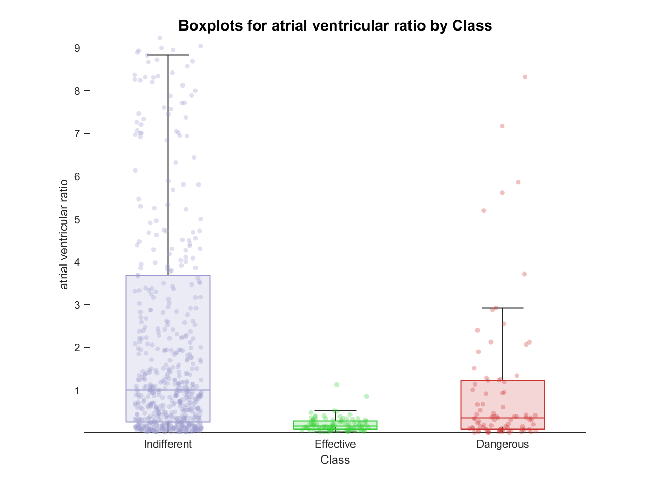
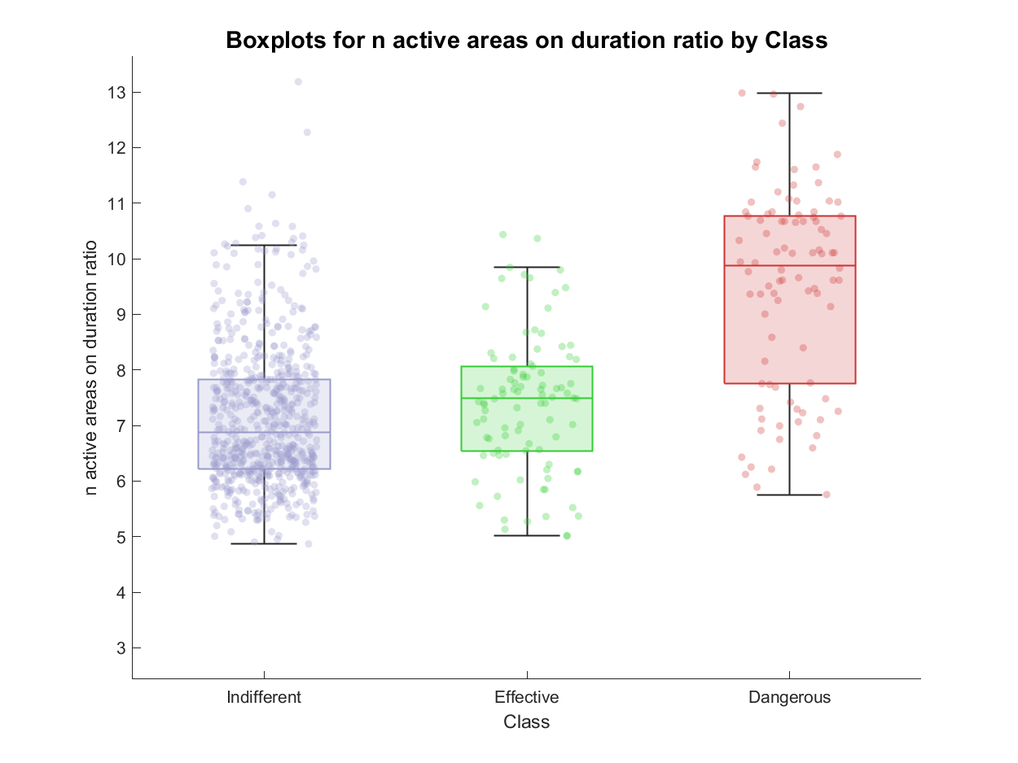
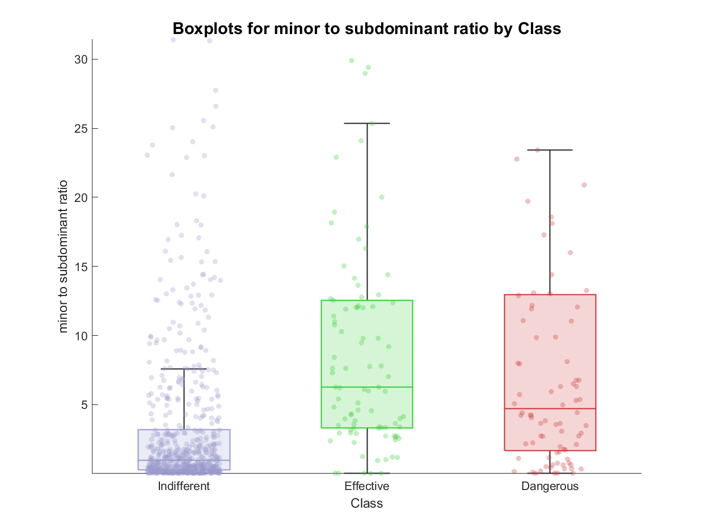
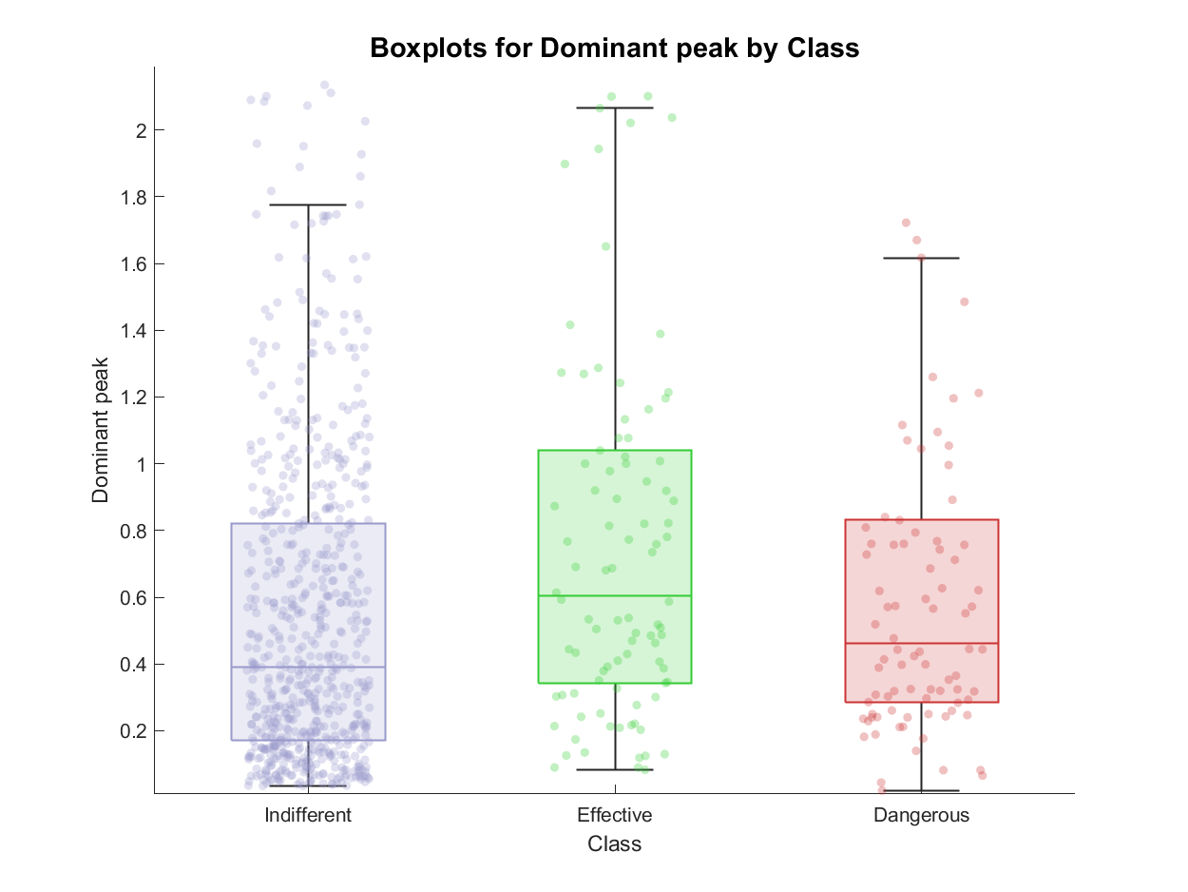
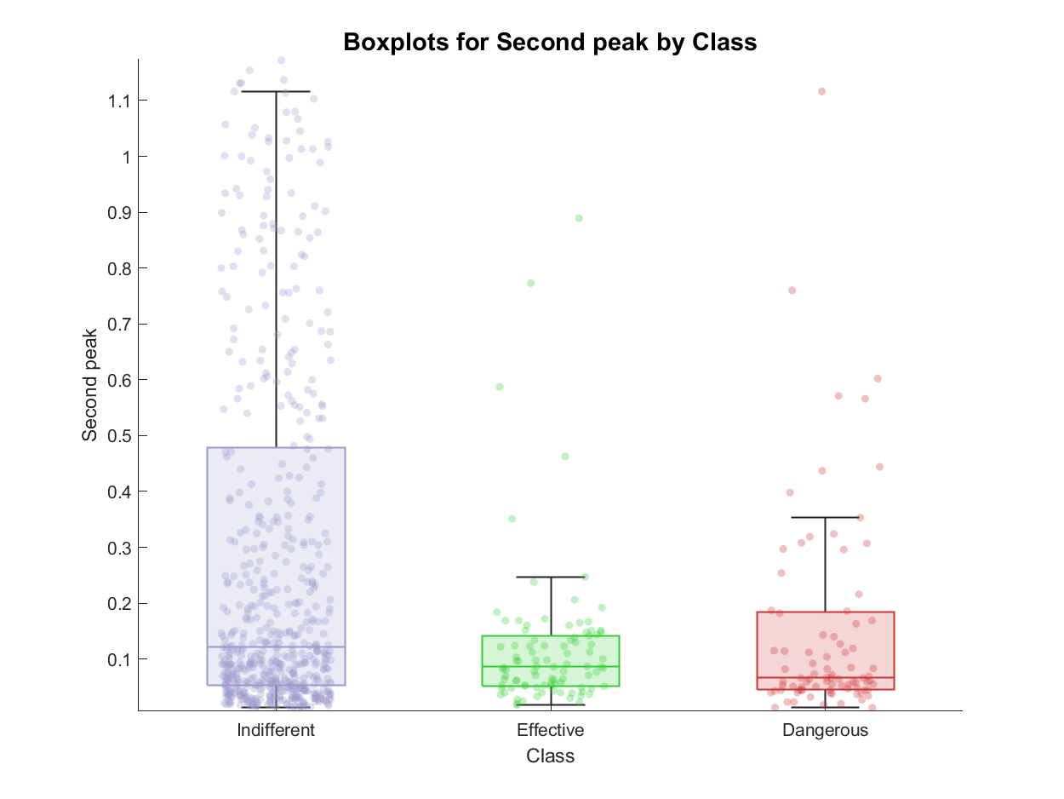
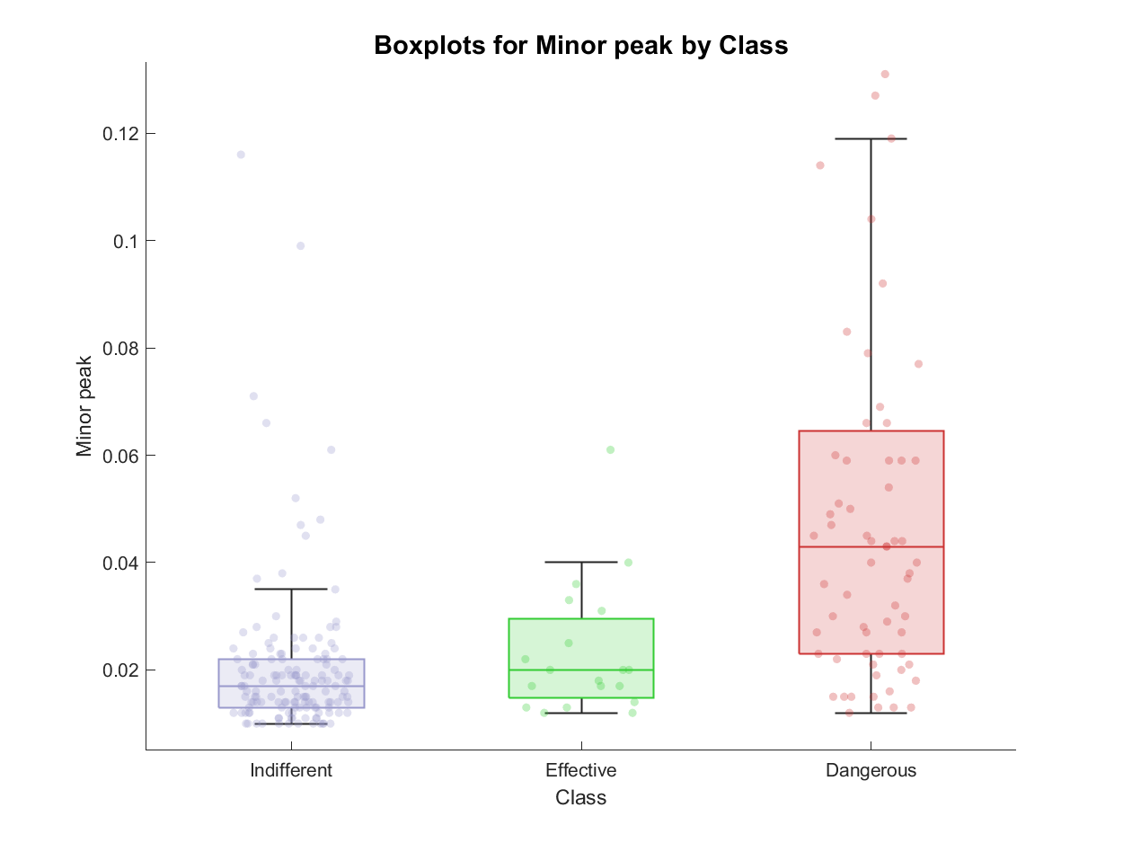
Envelope feature extraction: examples of features

Slide 9
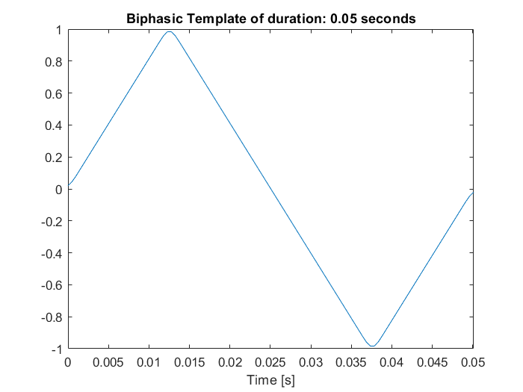
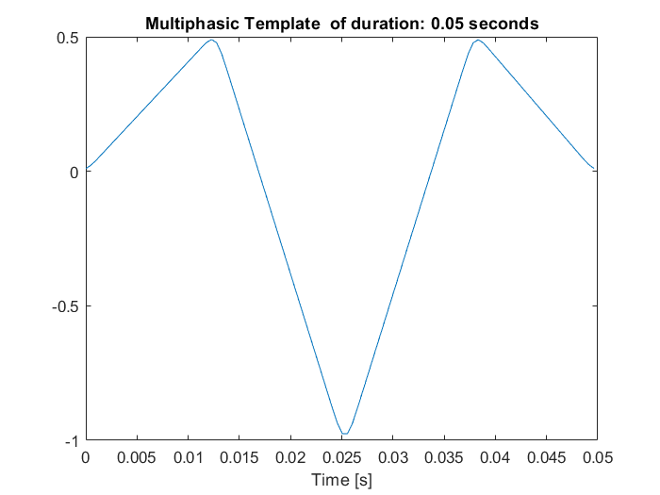
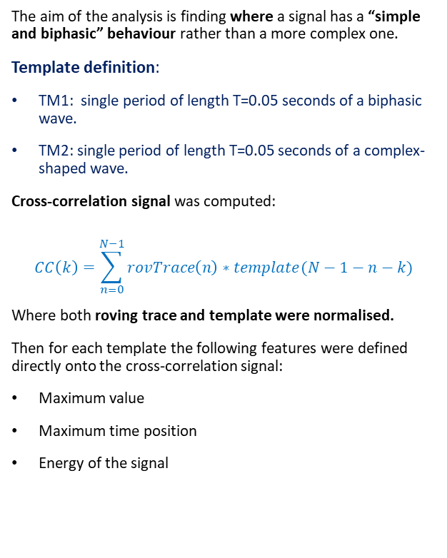
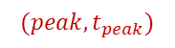
Template matching definition
The aim of the analysis is finding where a signal has a “simple and biphasic” behaviour rather than a more complex one.
Template definition:
TM1: single period of length T=0.05 seconds of a biphasic wave.
TM2: single period of length T=0.05 seconds of a complex-shaped wave.
Cross-correlation signal was computed:
$$CC\left(k\right)=\sum_{n=0}^{N−1}{rovTrace\left(n\right)∗template(N−1−n−k)}$$
Where both roving trace and template were normalised.
Then for each template the following features were defined directly onto the cross-correlation signal:
Maximum value
Maximum time position
Energy of the signal
Vedi note
$$(peak,t_{peak})$$

Slide 10
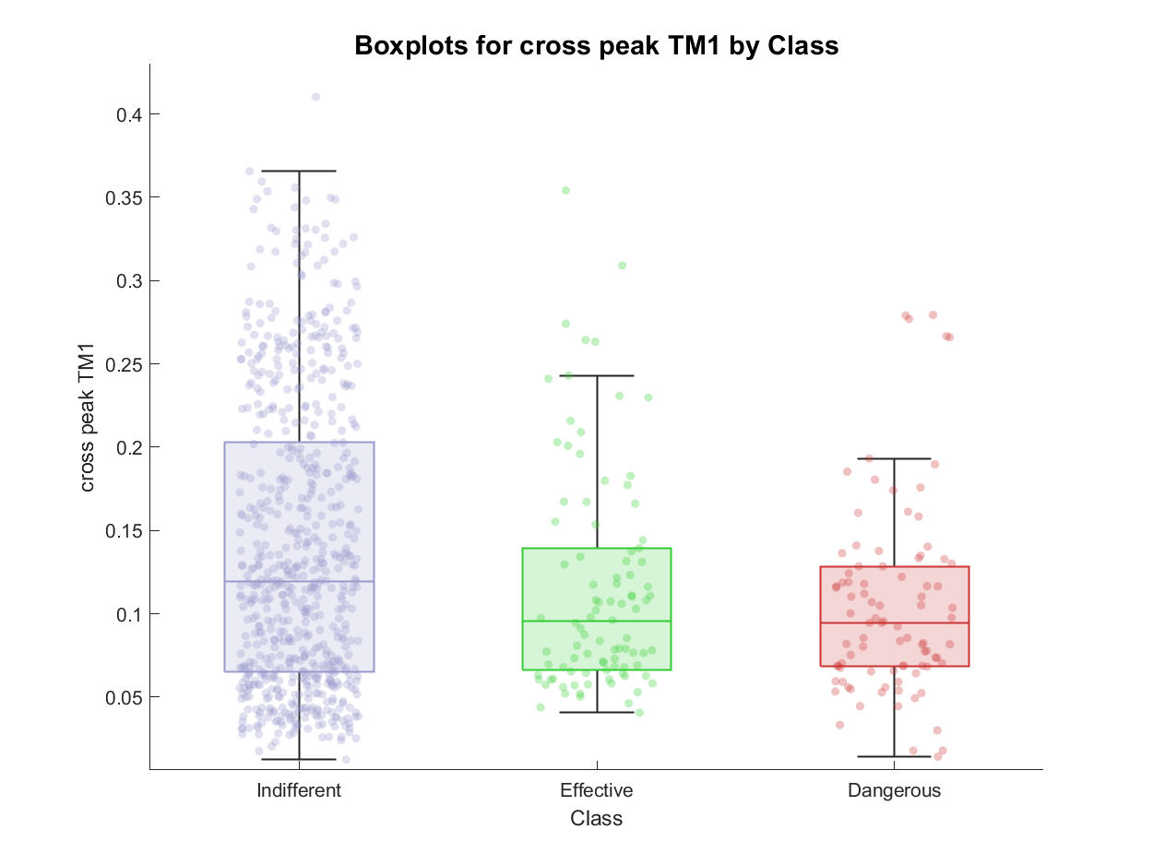
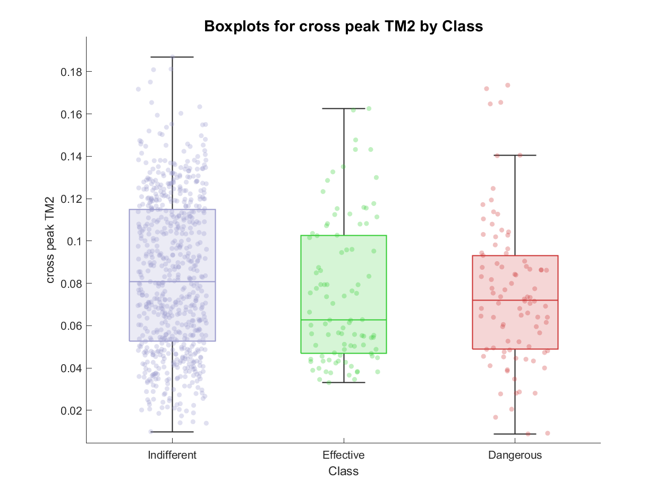
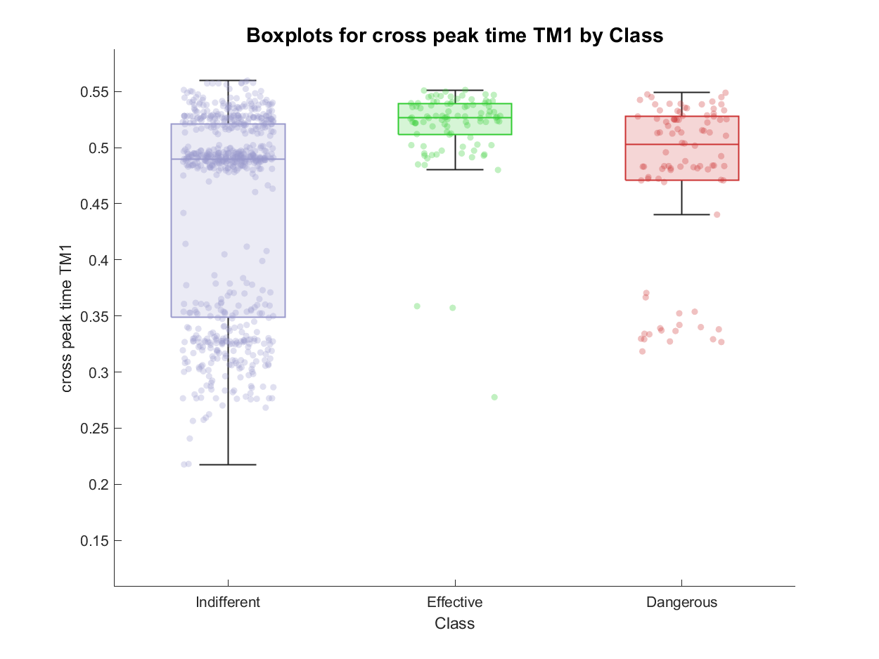
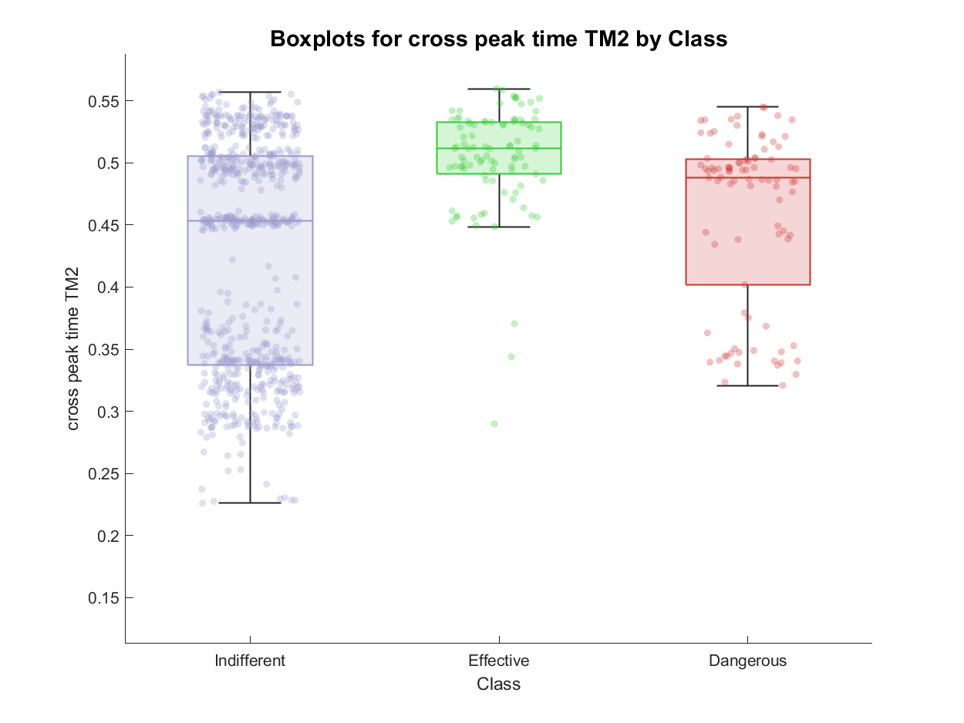
TM feature extraction: examples of features

Slide 11
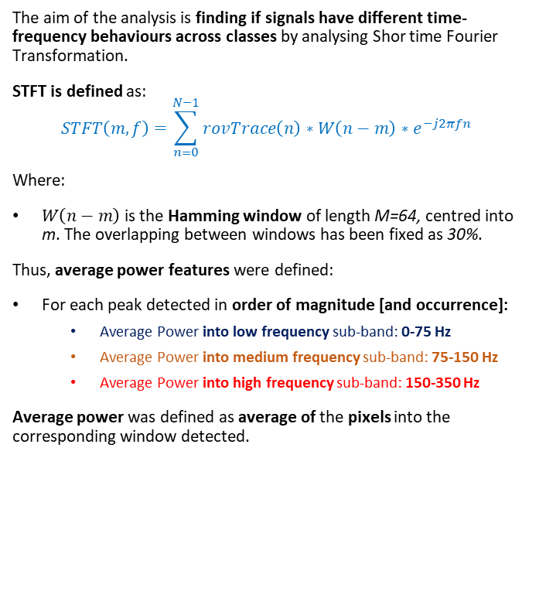
STFT definition
The aim of the analysis is finding if signals have different time-frequency behaviours across classes by analysing Shor time Fourier Transformation.
STFT is defined as:
$$STFT\left(m,f\right)=\sum_{n=0}^{N−1}{rovTrace\left(n\right)∗W\left(n−m\right)∗e^{−j2πfn} }$$
Where:
$W\left(n−m\right)$ is the Hamming window of length M=64, centred into m. The overlapping between windows has been fixed as 30%.
Thus, average power features were defined:
For each peak detected in order of magnitude [and occurrence]:
Average Power into low frequency sub-band: 0-75 Hz
Average Power into medium frequency sub-band: 75-150 Hz
Average Power into high frequency sub-band: 150-350 Hz
Average power was defined as average of the pixels into the corresponding window detected.
Vedi note
avg
avg
avg
avg
avg
avg
avg
avg
avg

Slide 12
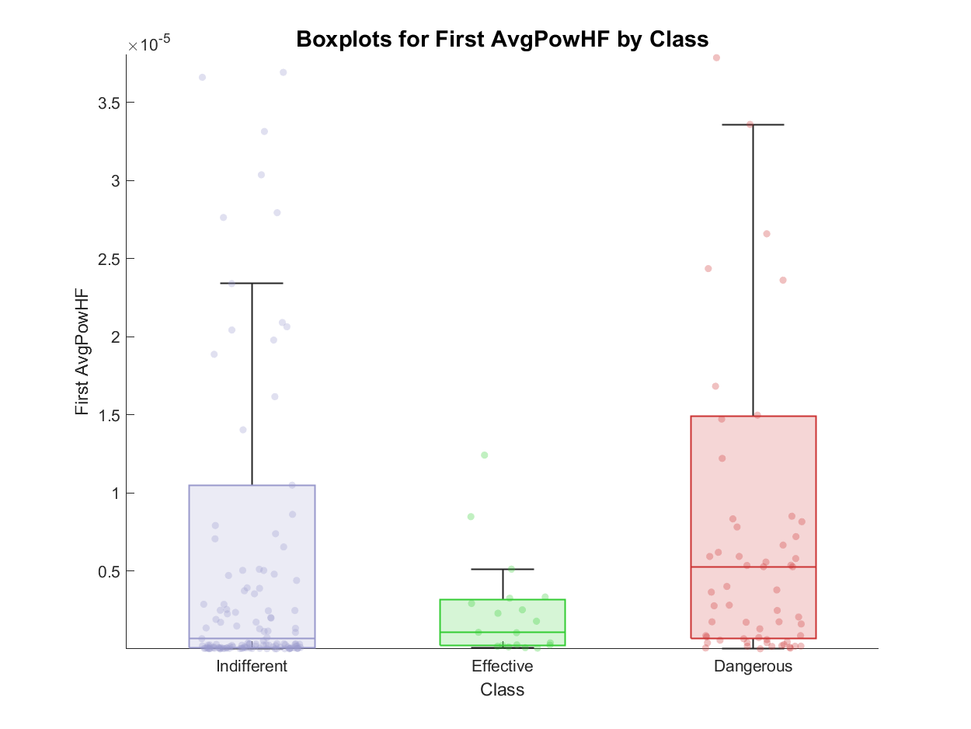
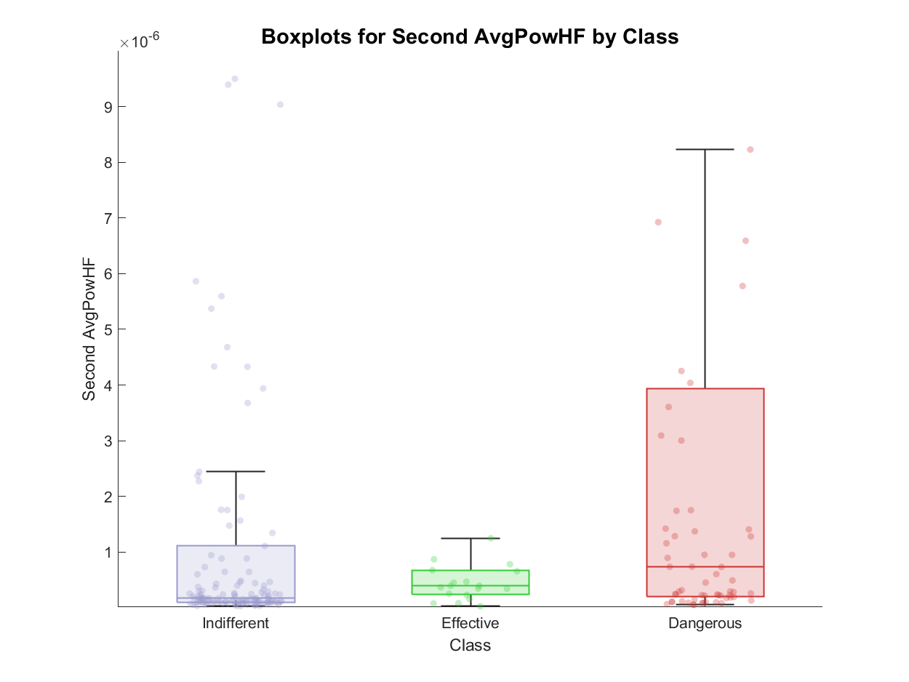
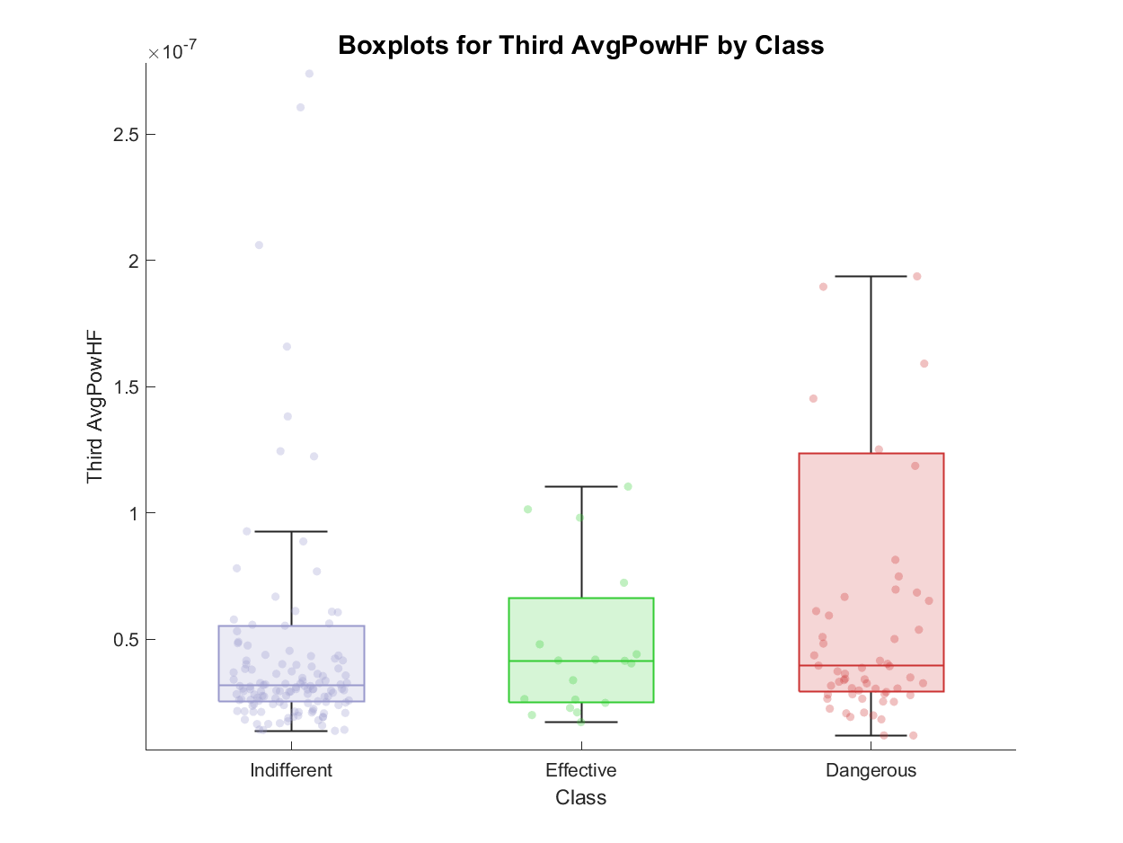
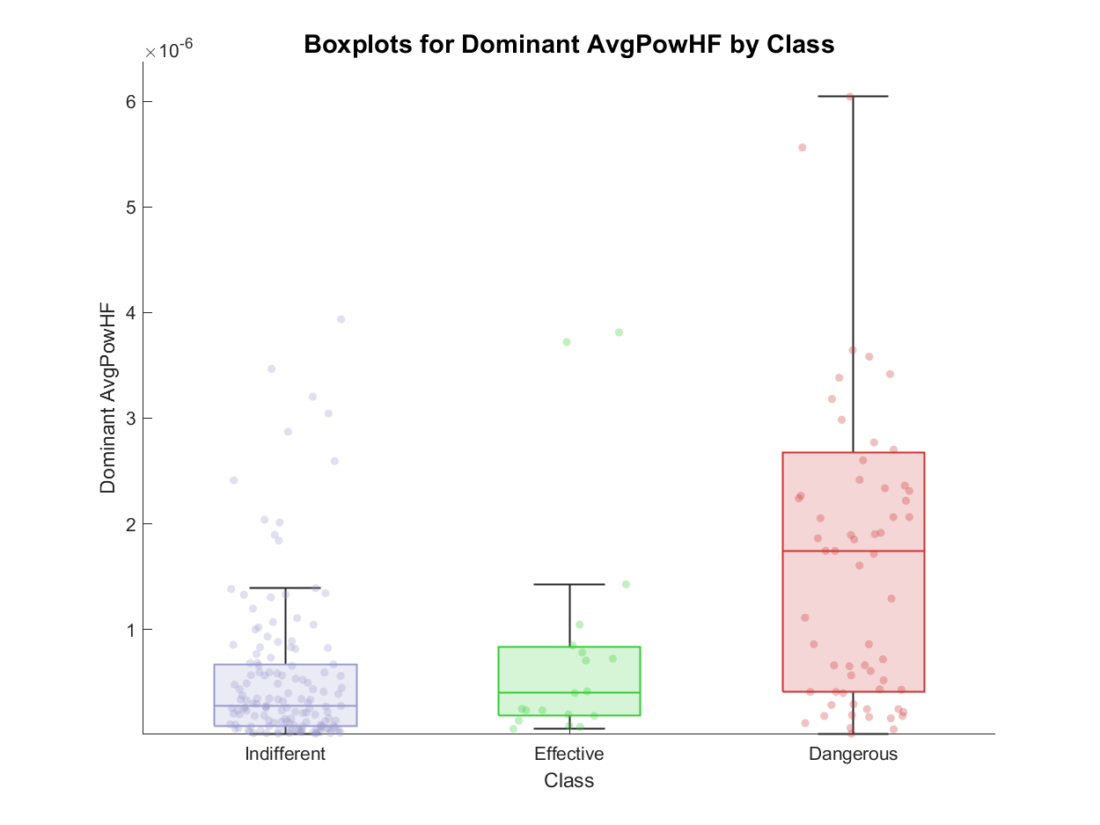
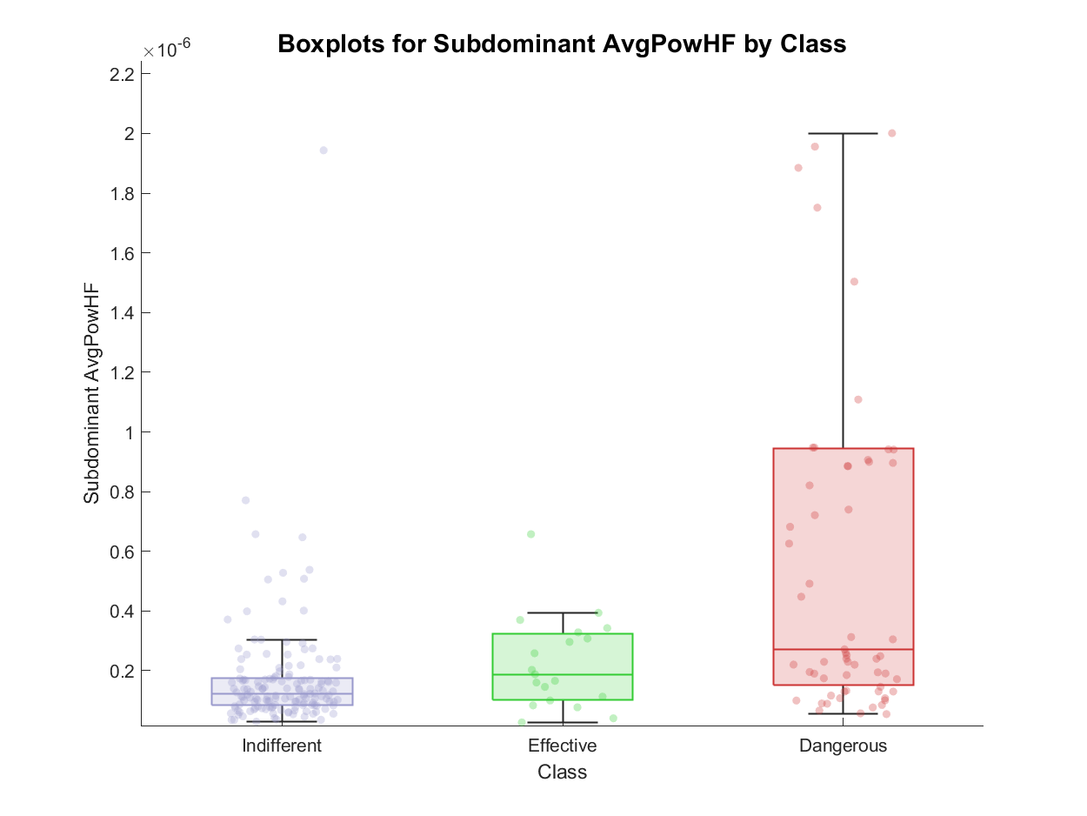
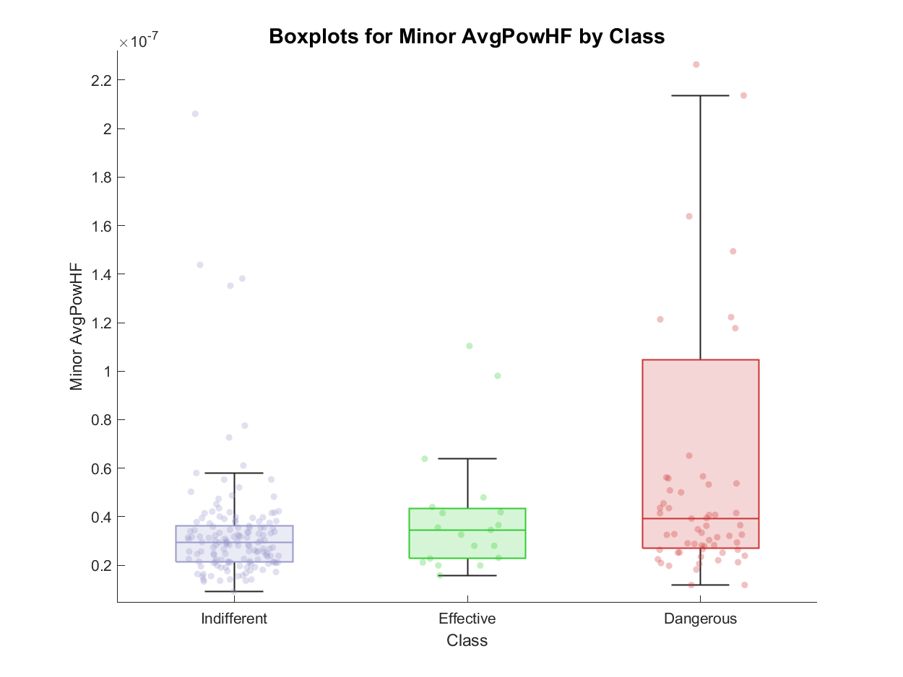
STFT feature extraction: examples of features

Slide 13
Outline
Problem statement: recap
Feature extraction
Envelope features
Template matching features
Short time Fourier transformation features
Classification
Feature correlation analysis
Knowledge based approach
Machine learning approach: tree - MLR - SVM
Best model evaluation
Conclusions

Slide 14
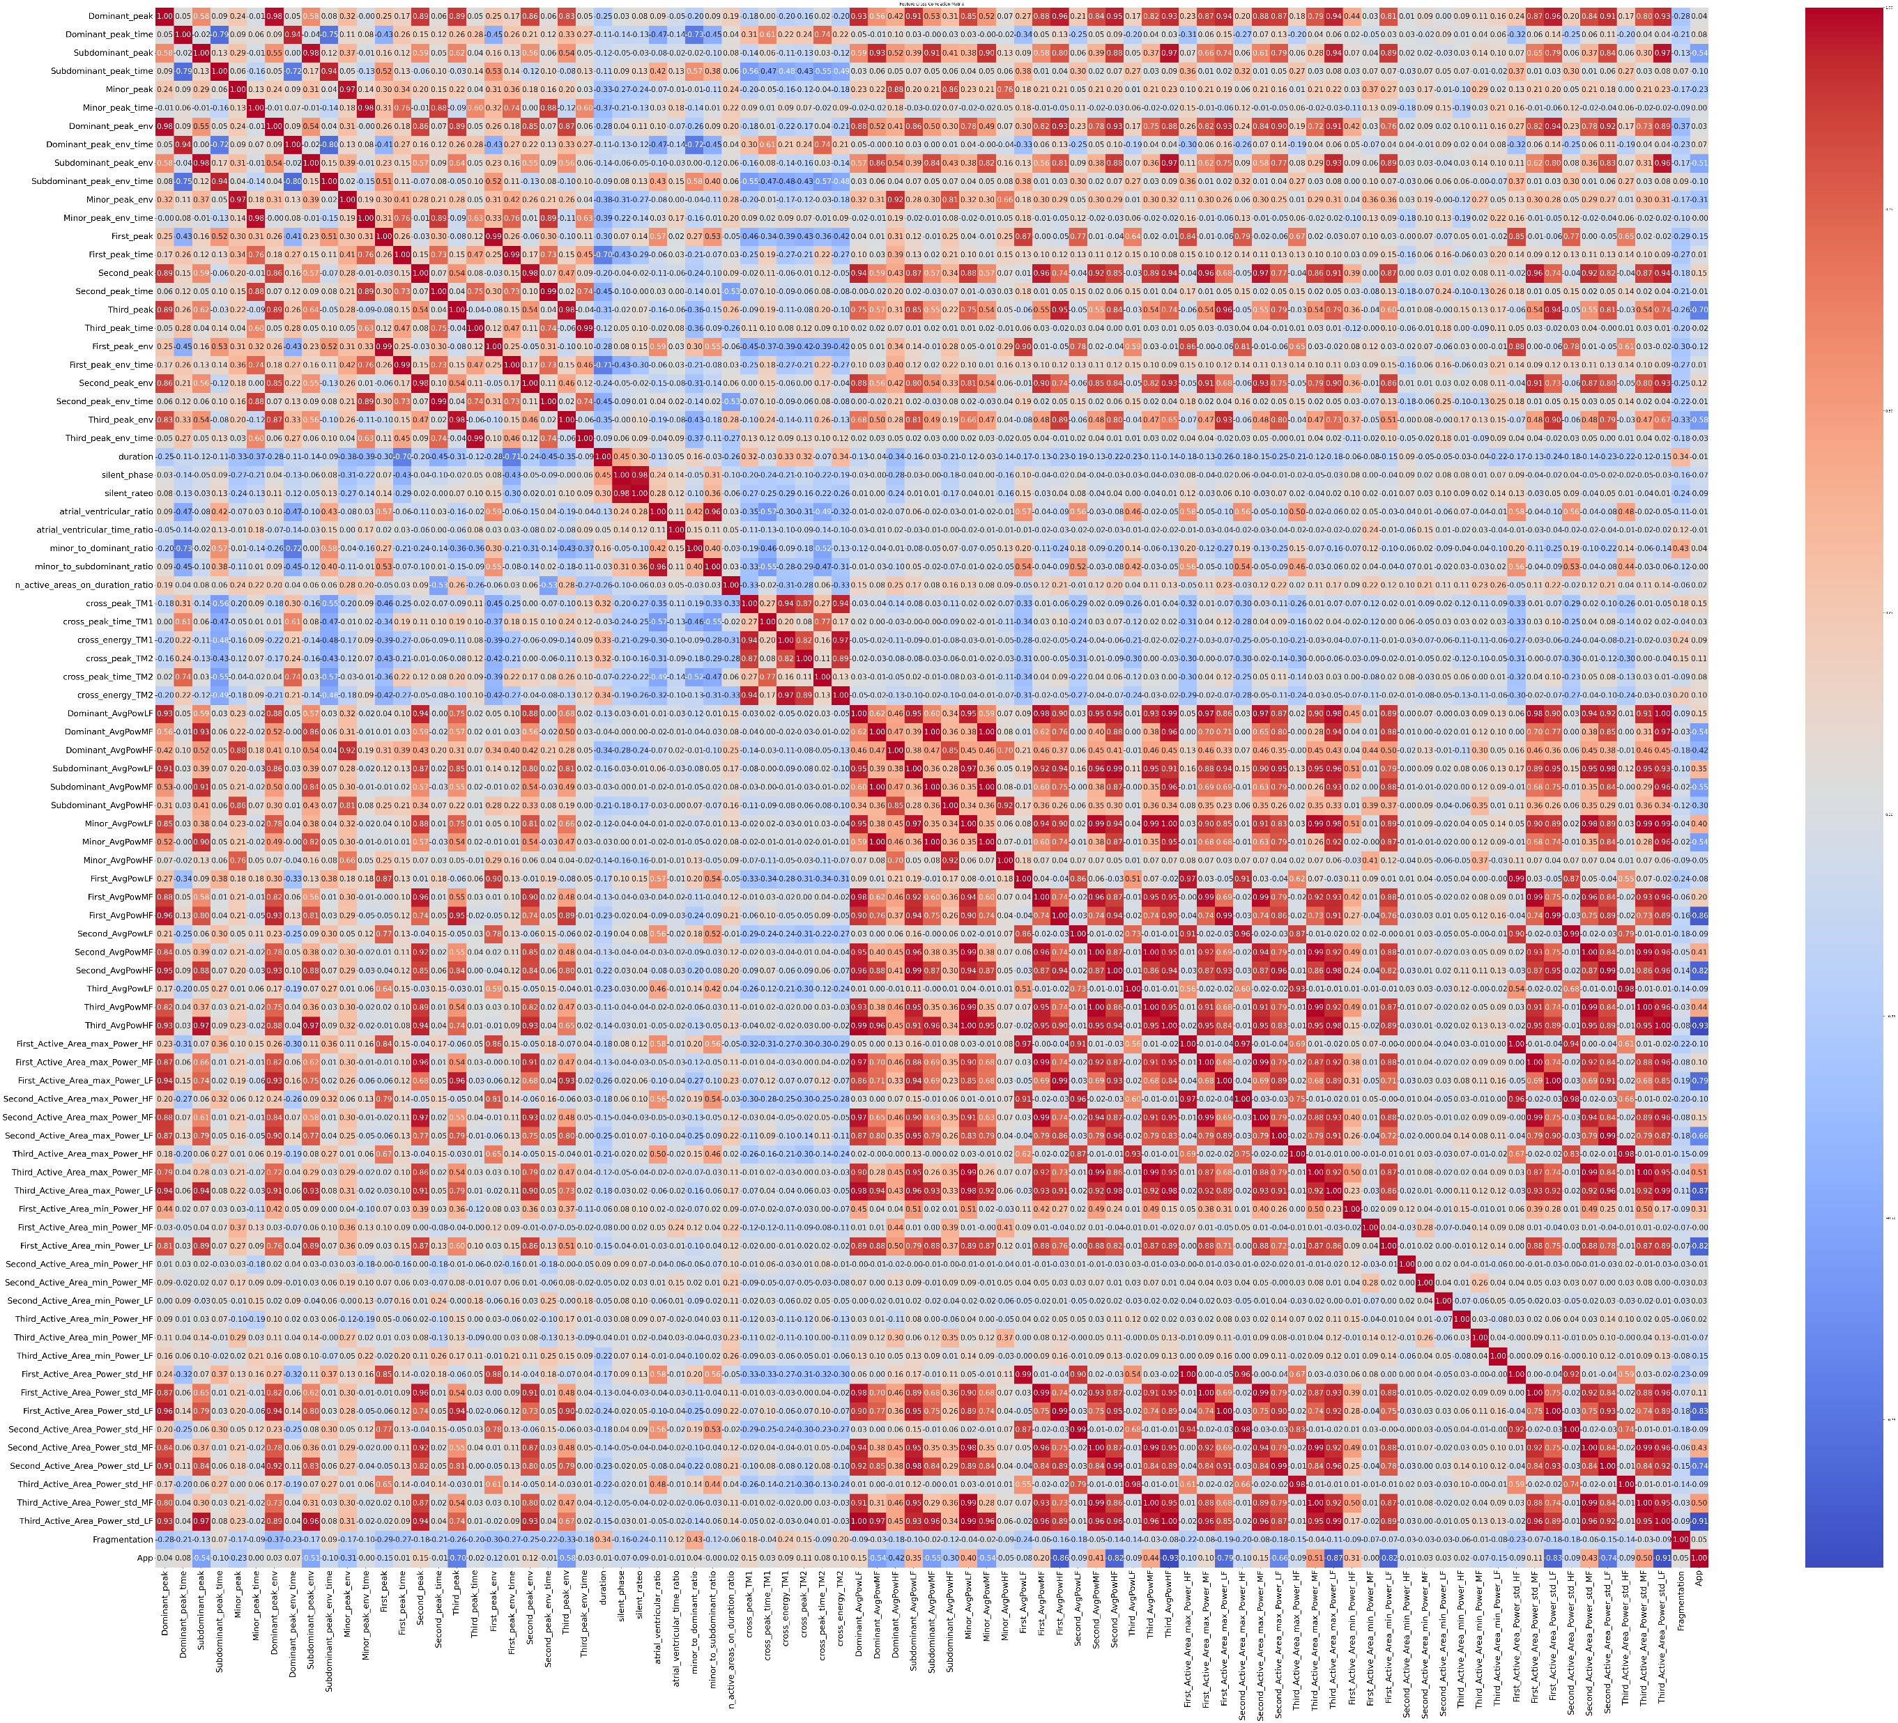
Feature correlation analysis
To avoid the usage of features correlated between each other, correlation matrix has been computed and some of:
Envelope features
Template Matching features
STFT features
Literature inspired features
Were excluded from the analysis
From an initial number of 87 features, a dataset of 56 features was obtained.

Slide 15
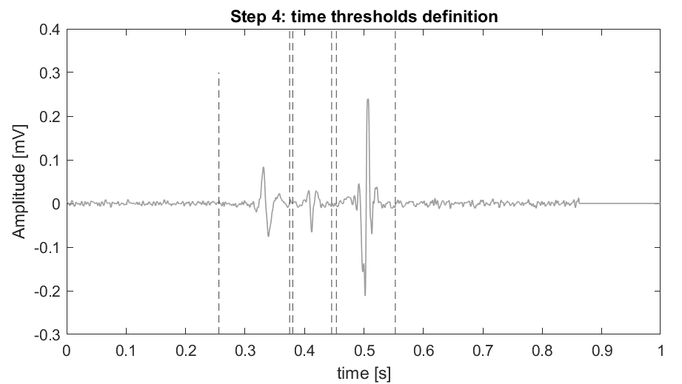
Knowledge based classifier
Four knowledge-based classifiers were defined, and the best one is reported.
Aim: assess if a KB classifier can meet the problem
Feature extraction
Is Minor_peak >0.021?
No
Is Dominant_peak_time <0.49
No
Effective
Yes
Yes
Dangerous
Indifferent

Slide 16
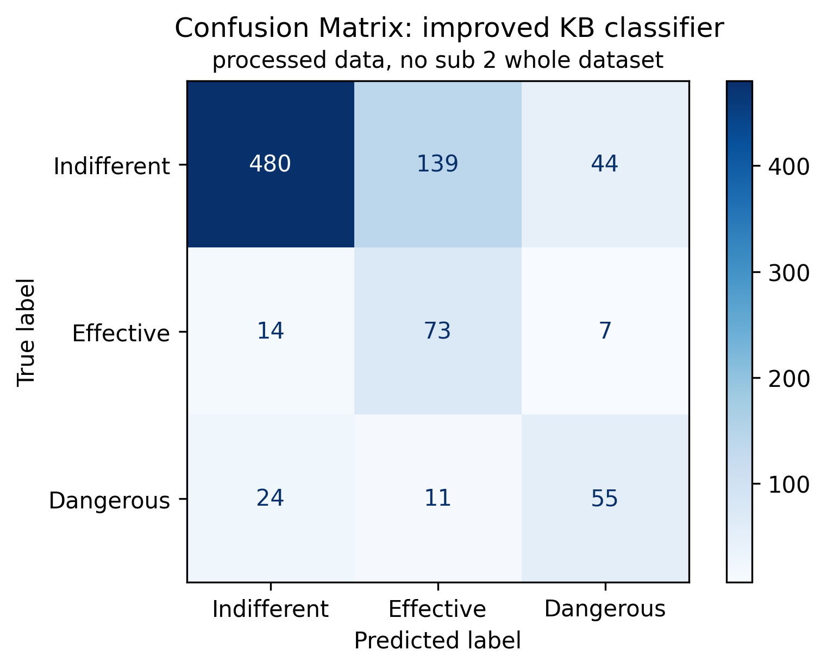
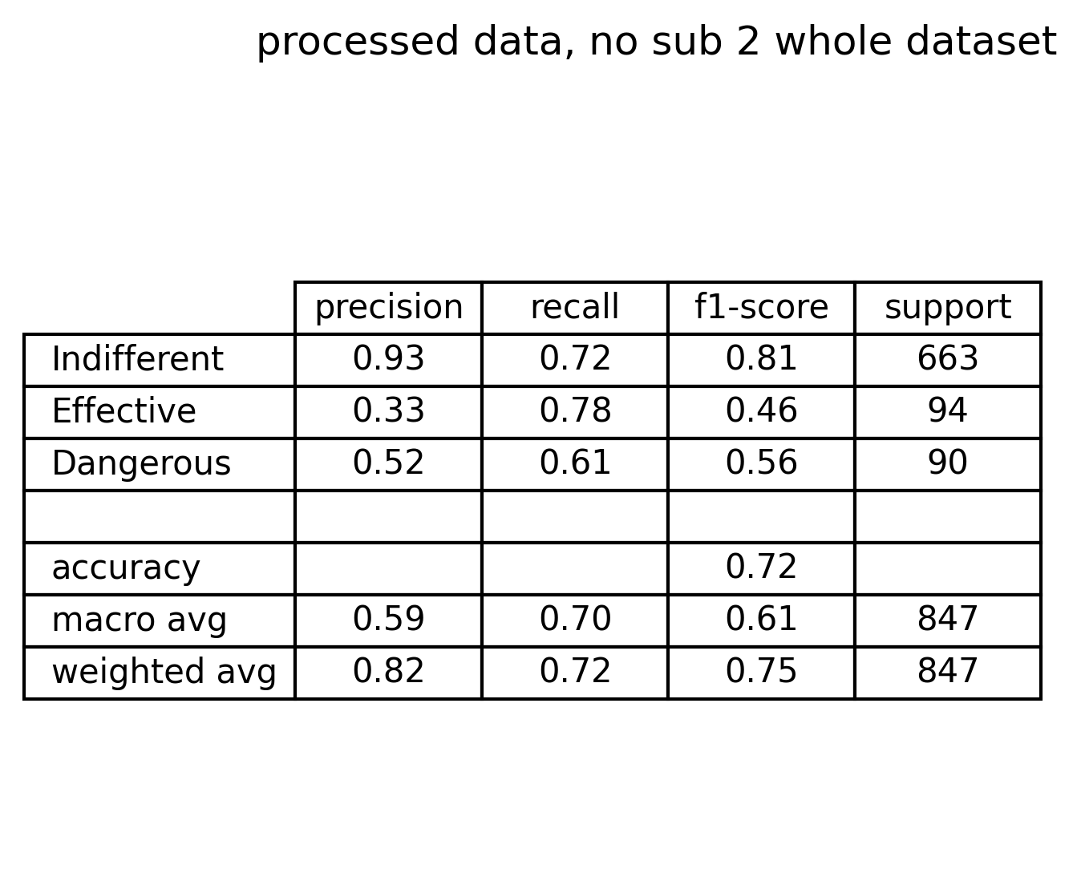
Knowledge based classifier performance
Comments on confusion matrix and metrics:
Indifferent signals have good performance
Effective signals suffer of bad precision but sufficient recall
Dangerous signals suffer of both low precision and recall
There are 11 dangerous signals classified as effective (very critical scenario)
There are 44 indifferent signals recognized as dangerous (acceptable scenario)
There are 24 dangerous signals classified as indifferent (risky scenario)

Slide 17
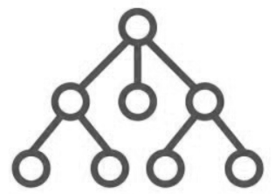
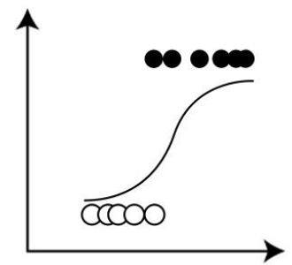
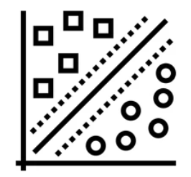
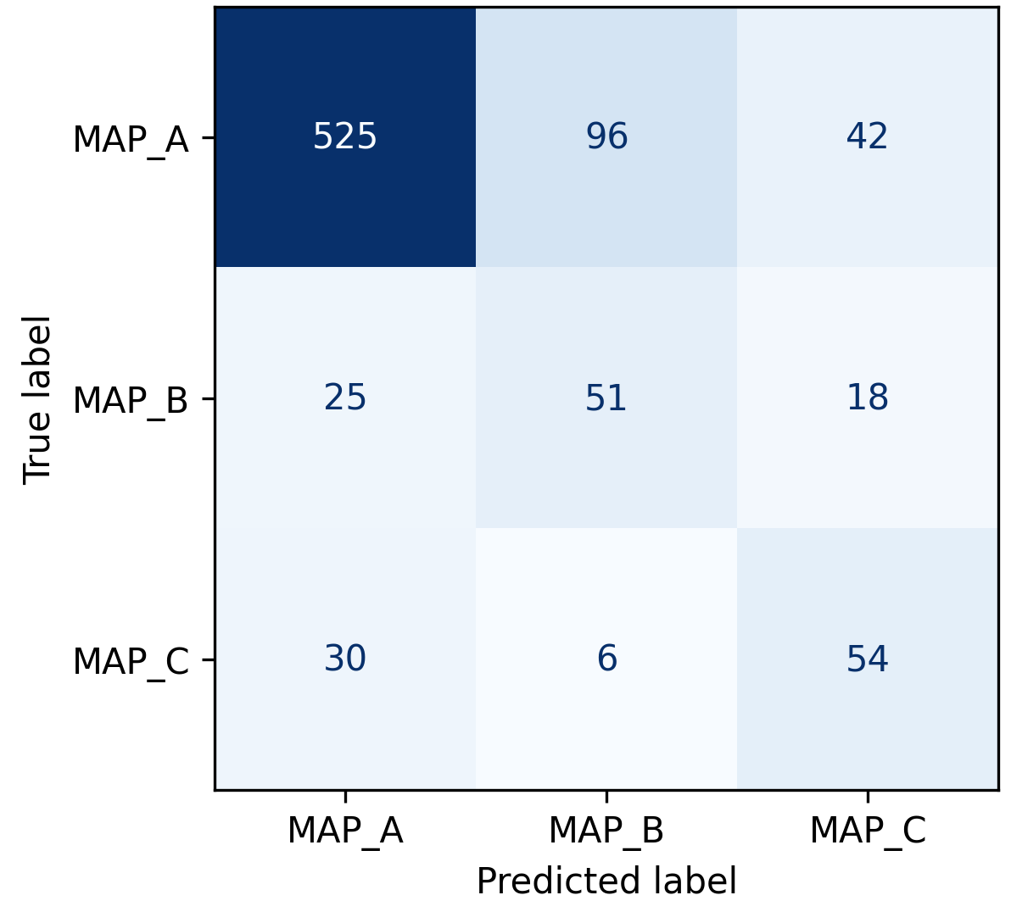
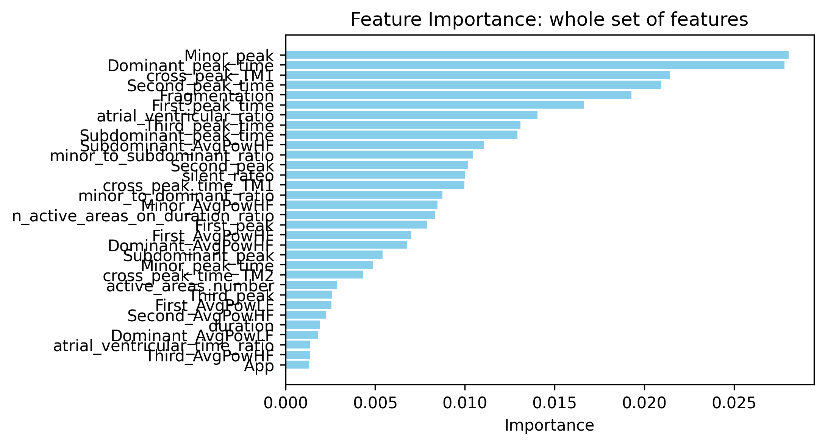
Machine learning approaches
Tree different machine learning models were used:
Tree classifier: simple and fully explainable, is similar to the knowledge-based approach
Multinomial logistic regression: simple and interpretable, provides a probabilistic output
Support vector machine classifier: less simple and hardly interpretable, capture nonlinear relationships and separability of classes
Models were validated using Leave One Patient Out cross validation and classification metrics, together with feature importance, were computed.
Each model were first built onto the whole feature set, then reduced to the optimal feature subset (reported results)
Feature extraction
LOPOCV

Slide 18
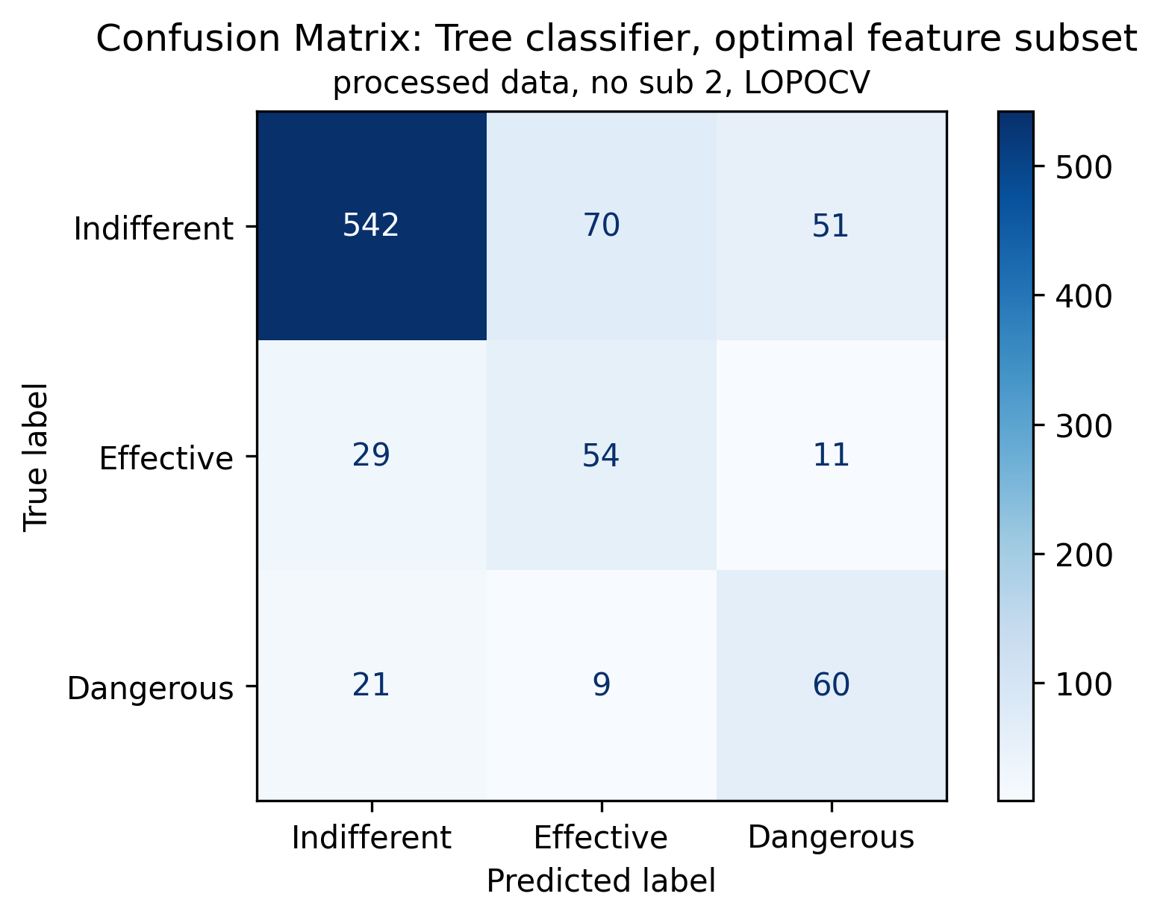
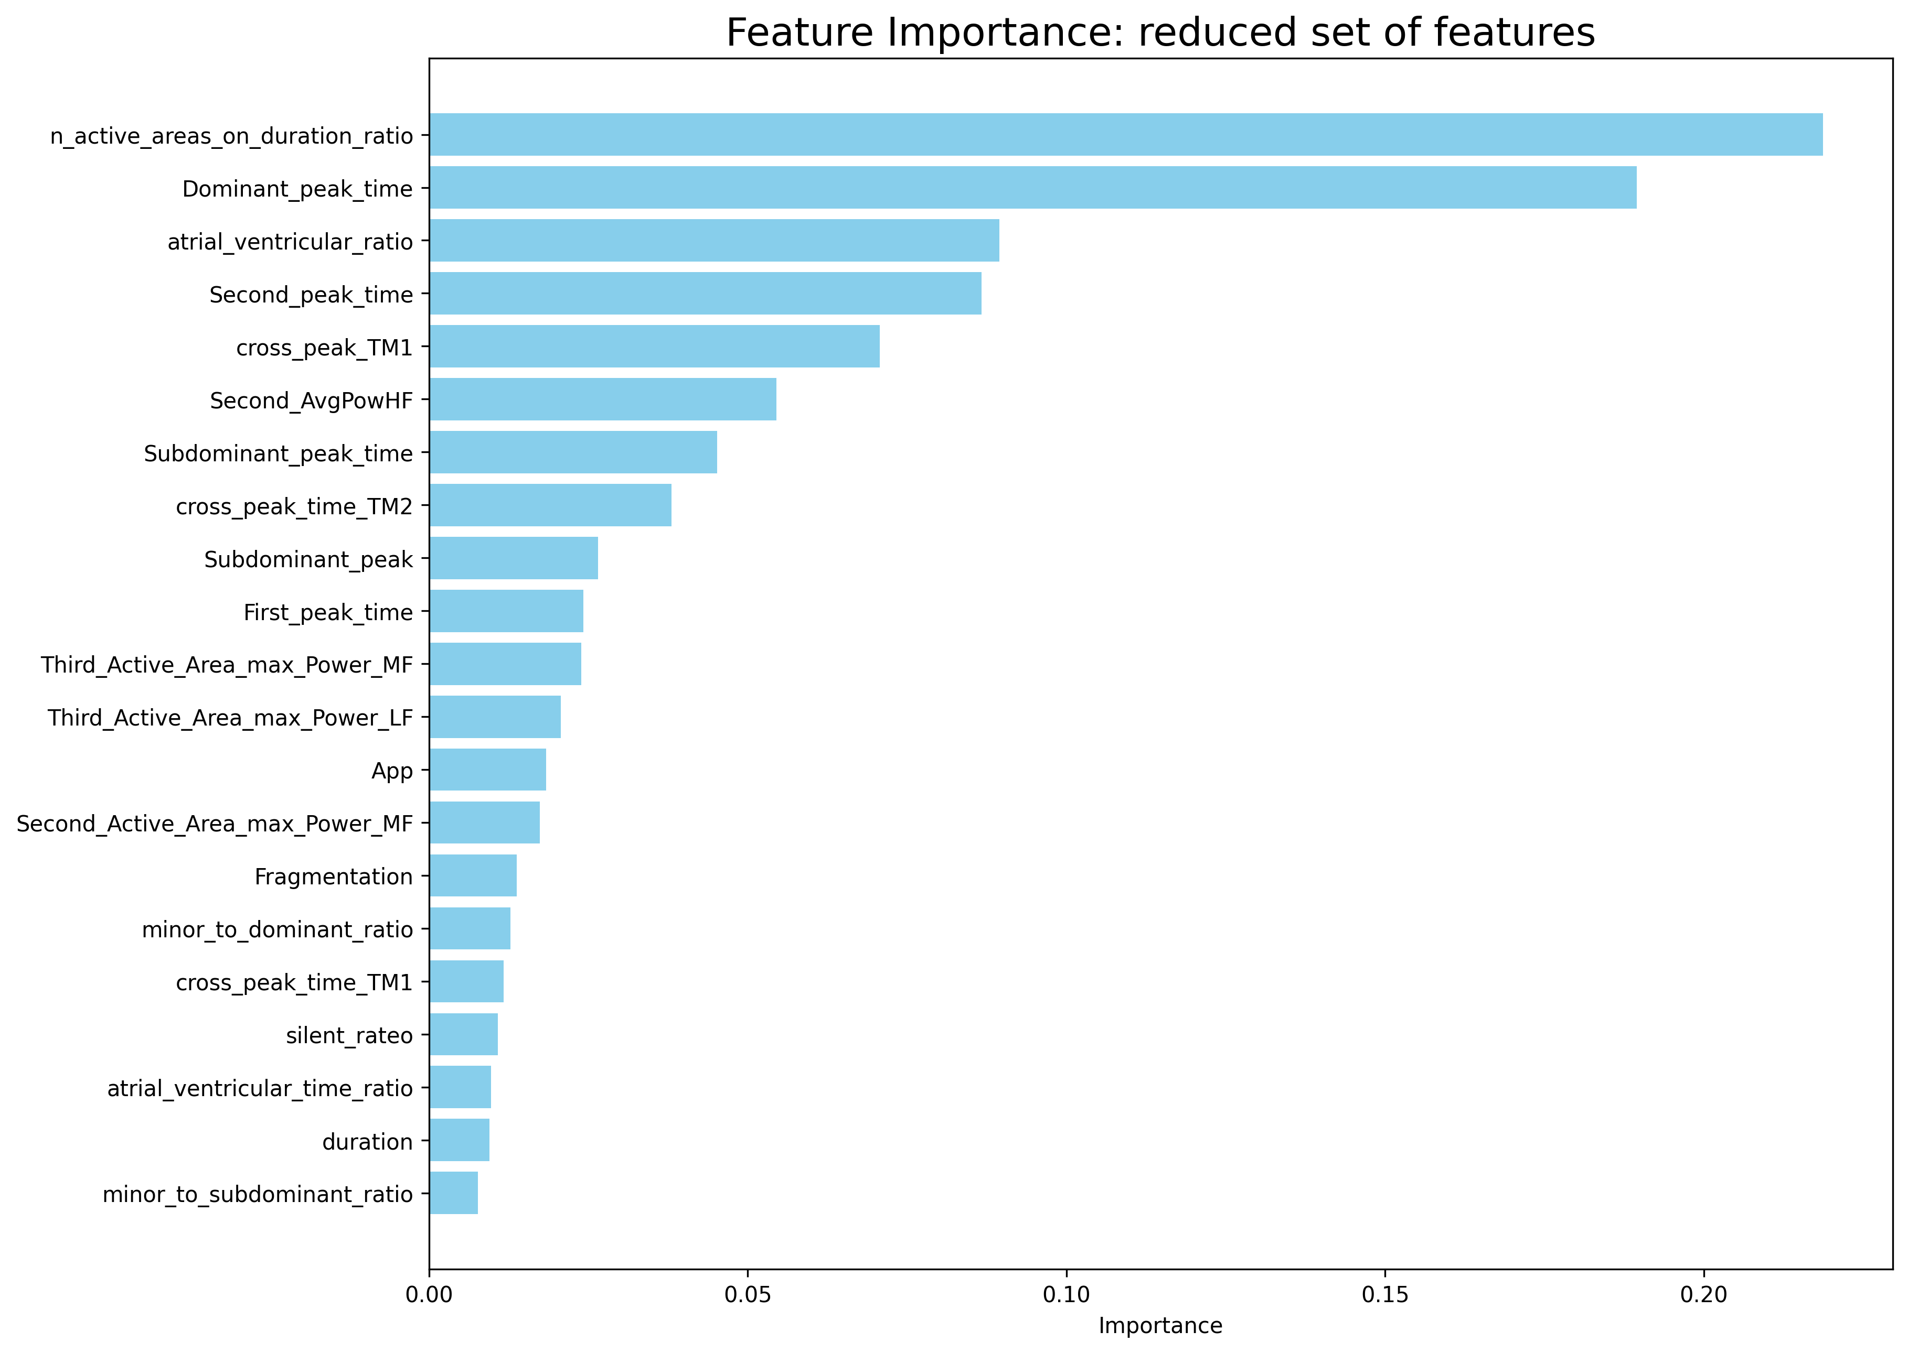
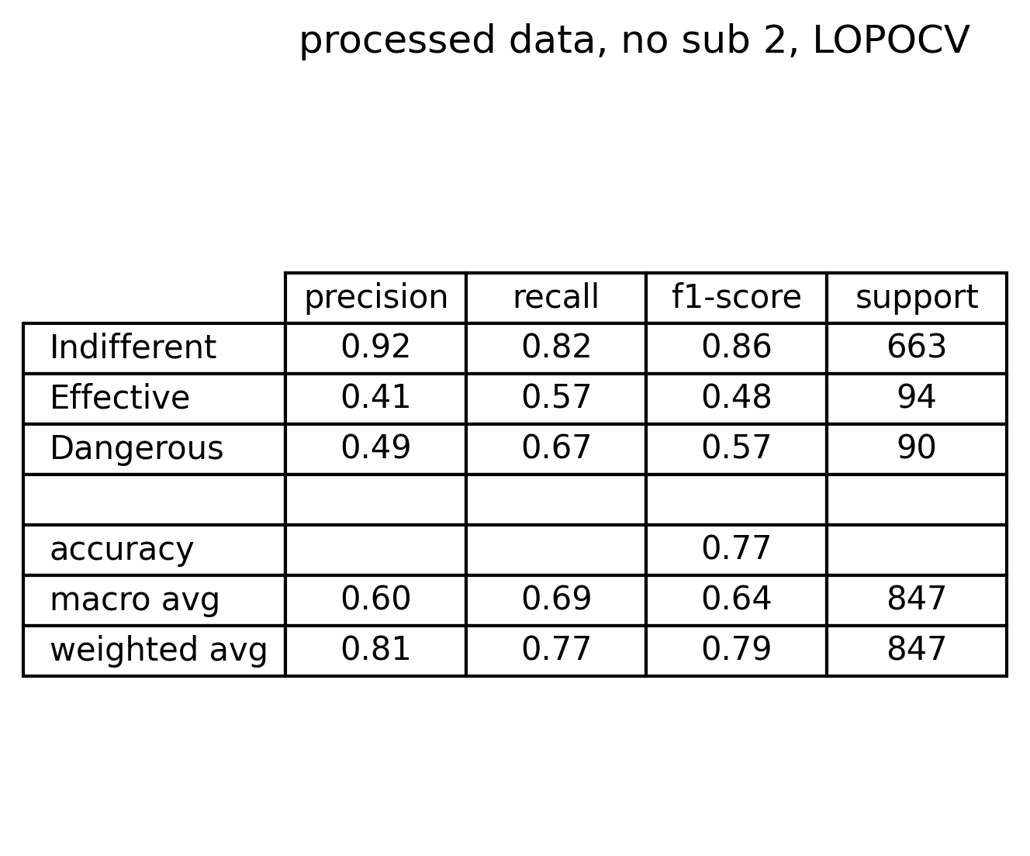
Tree classifier – optimal subset of features
Cross entropy impurity measure
Depth tuned on weighted f1-score
Comments on confusion matrix and metrics:
Indifferent signals have good performance
Effective signals suffer of bad precision and low recall
Dangerous signals suffer of both low precision and recall
There are 9 dangerous signals classified as effective (very critical scenario)
There are still 70 effective signals recognized as indifferent
There are 51 indifferent signals recognized as dangerous (acceptable scenario)
There are 21 dangerous signals classified as indifferent (risky scenario)

Slide 19
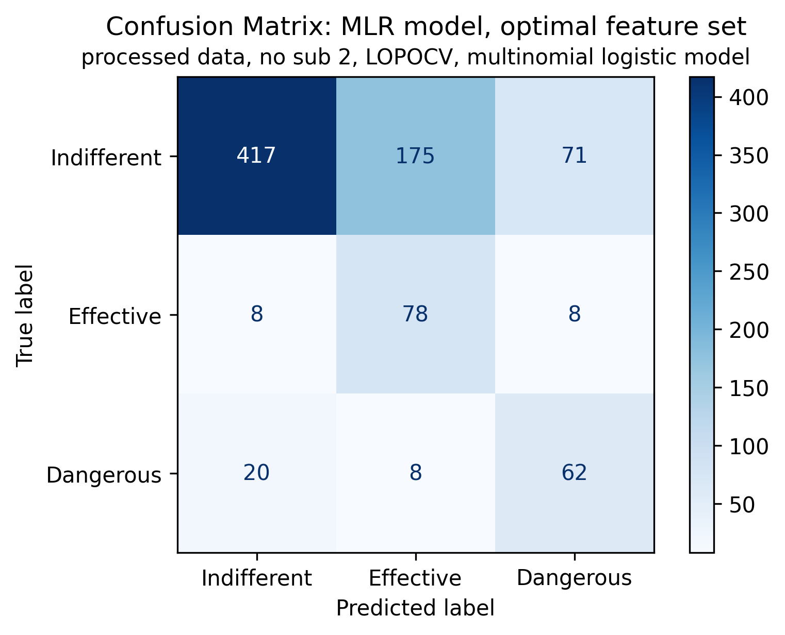
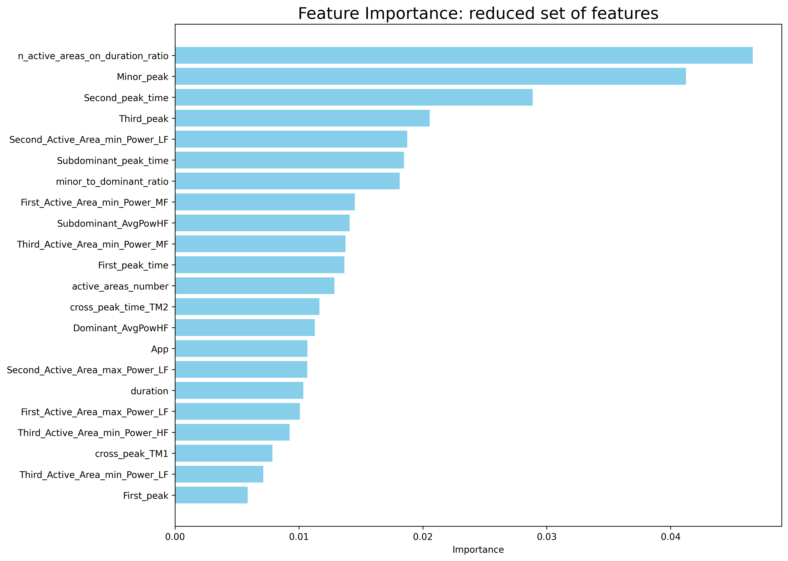
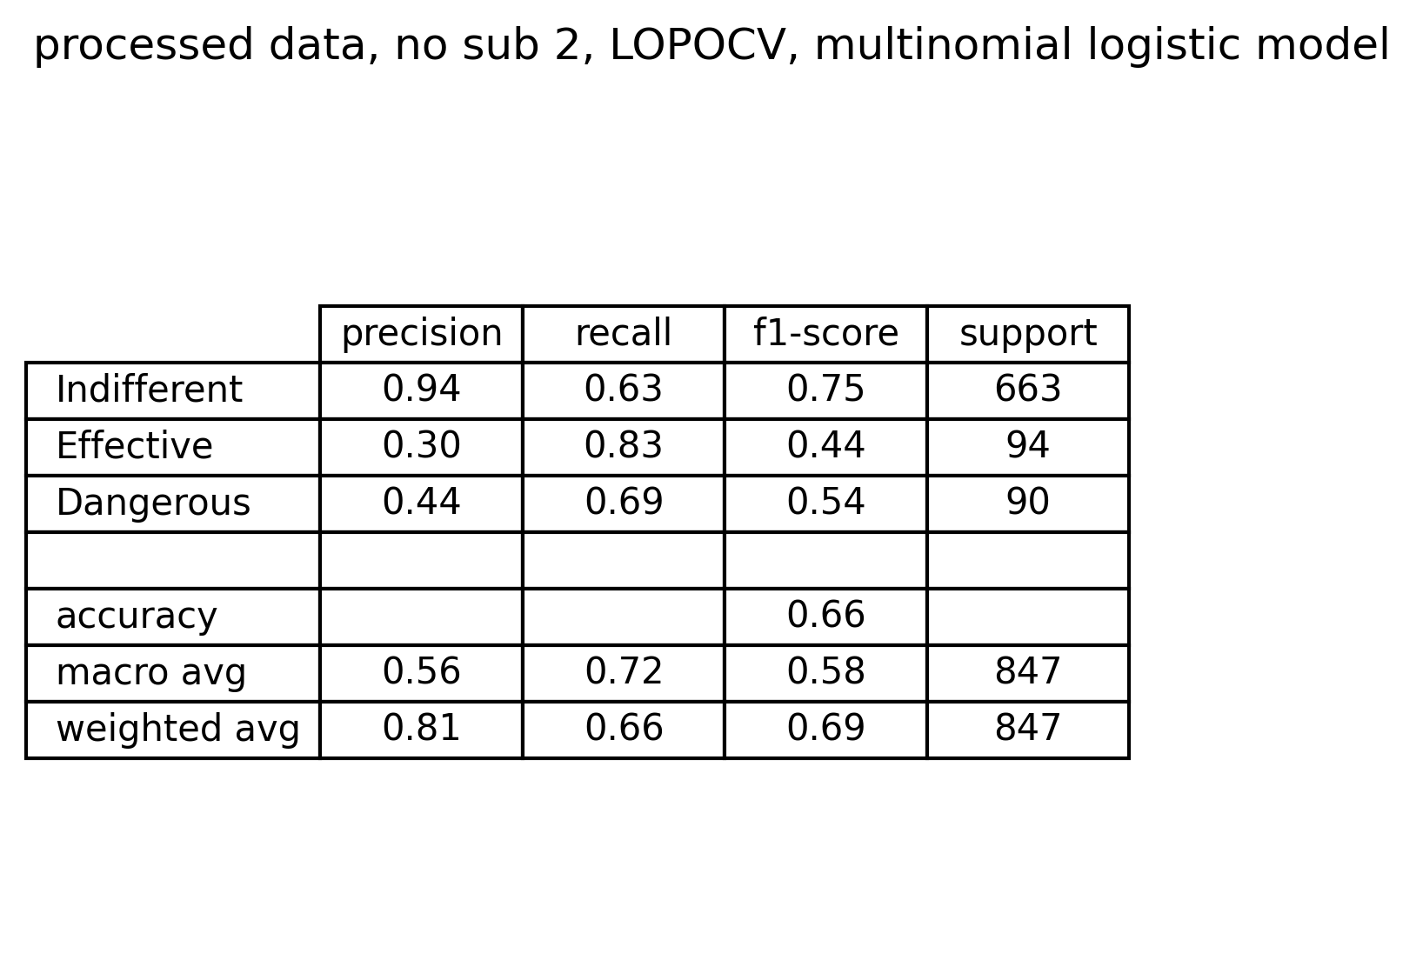
MLR classifier – optimal subset of features
Multinomial classification
1000 maximum iterations
Comments on confusion matrix and metrics:
Despite the good number of effective and dangerous signals correctly identified, there are:
8 dangerous signals recognized as effective (unacceptable)
175 effective signals predicted as indifferent (as done by the knowledge-based classifier)
71 dangerous signals recognized as indifferent (acceptable)
20 indifferent signals recognized as dangerous (risky)

Slide 20
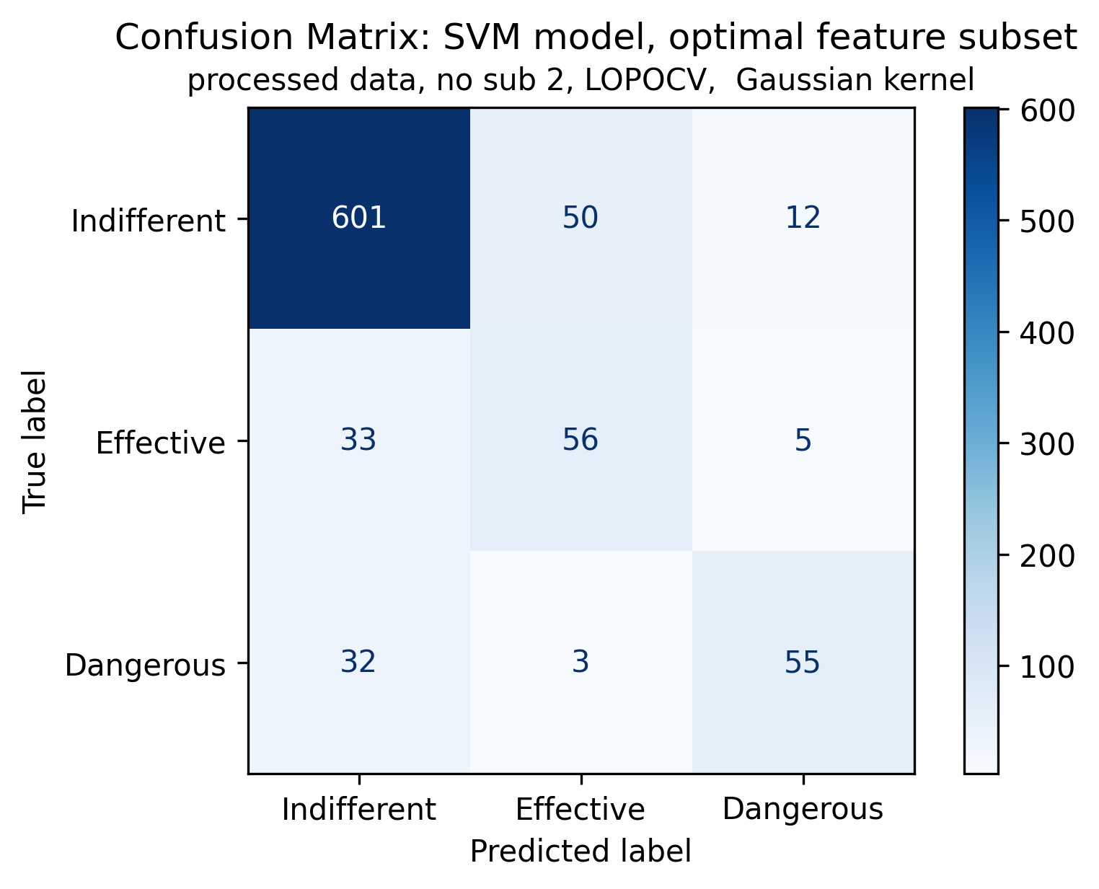
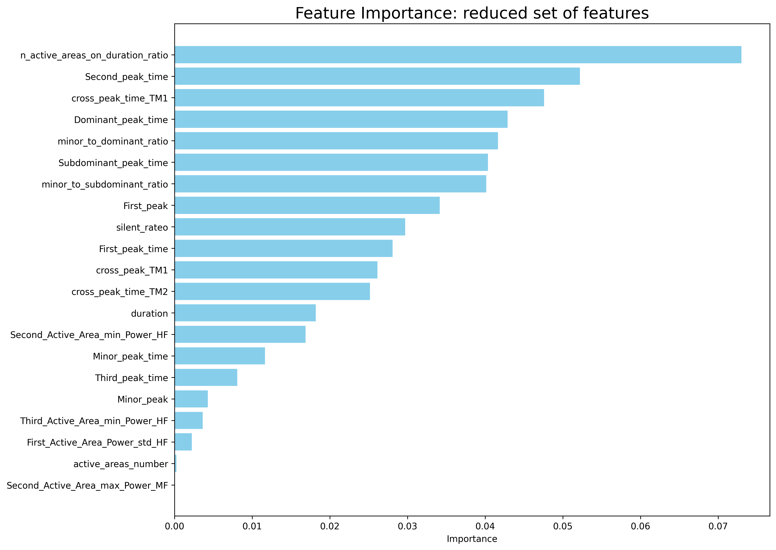
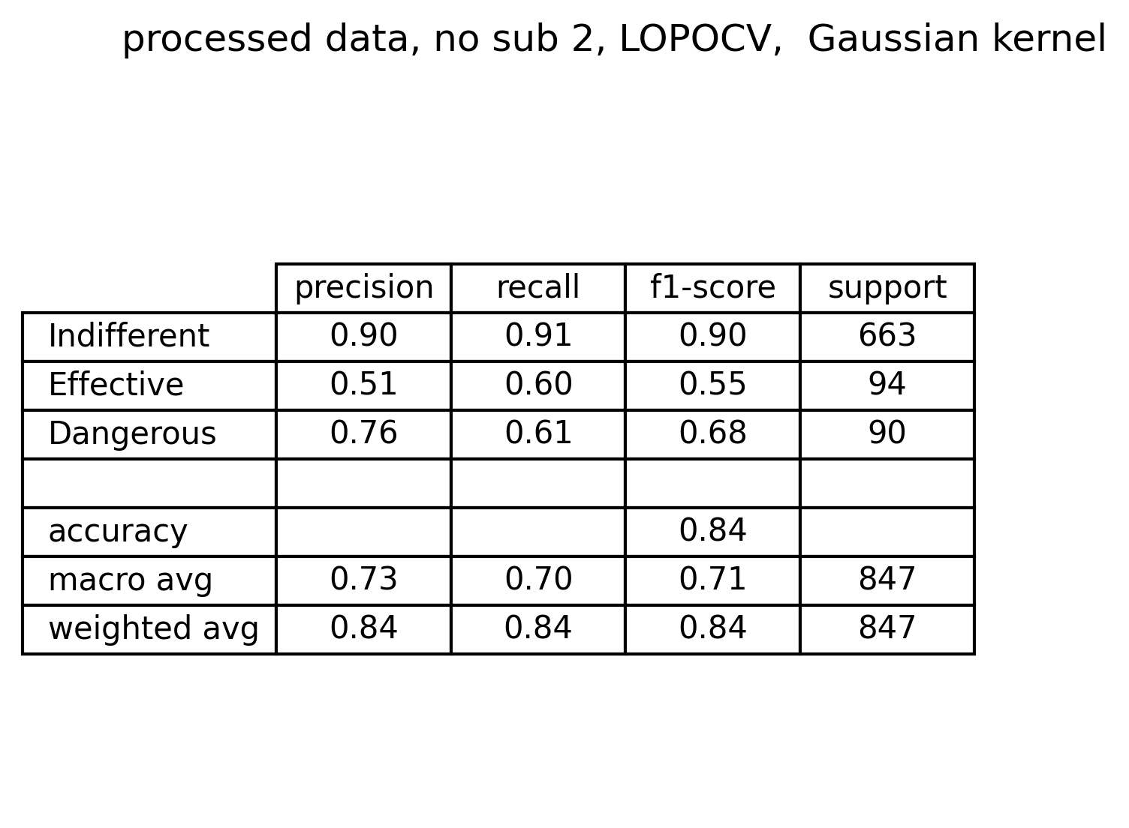
SVM classifier – optimal subset of features
Gaussian kernel
C value tuned on f1-score
Comments on confusion matrix and metrics:
Performance overall improves:
Highest f1-score levels
Still a considerable number of misclassified signals into each class
Lowest number of dangerous signals classified as effective

Slide 21
Model comparison: perfomance
Knowledge based
Decision Tree
Multinomial Logistic Regression
Support Vector Machine
Simple and completely explainable
Unsatisfactory performances overall
Simple and completely explainable
Improves KB performance, but there are still too many signals misclassified
Simple, explainable and probabilistic
Performs similarly to KB classifier, but metrics improves for effective and dangerous
Capture nonlinear relationships between features
Hardly explainable
Best performances overall

Slide 22
Model comparison: feature importance
Decision Tree
Multinomial Logistic Regression
Support Vector Machine
Envelope Features
Most common features
Number of active areas on total duration of active portion
Second peak time
Cross correlation peak value for TM1
Cross correlation peak time for TM2
Subdominant peak time
First peak time
Duration of active portion
Minor peak to dominant peak ratio
Morphological features
Envelope and morphological features
STFT features
Other features

Slide 23
Outline
Problem statement: recap
Feature extraction
Envelope features
Template matching features
Short time Fourier transformation features
Classification
Feature correlation analysis
Knowledge based approach
Machine learning approach: tree - MLR - SVM
Best model evaluation
Conclusions

Slide 24
Conclusions
Feature extraction pipeline defines three families of features:
Envelope features (active areas of the signal): These feature are the most important according to the feature importance of the models
Template matching (signal morphology.): These features cover a considerable role in classification
STFT features (average power across different frequency intervals): These features does not have a considerable impact on classification.
Classification phase led to the following conclusions:
Knowledge-based classifier is not sufficient to address properly the problem of classification
MLR model suggest that relationships between features are complex and nonlinear, especially the ones between indifferent and effective signals
Tree classifier outperforms the performances of both previous models because can capture more deeper relationships between features
SVM classifier, despite its complexity and lower explainability, reaches the highest performances, even in terms of dangerousness of misclassification errors
Vedi note su conclusion!!

